Slide 1
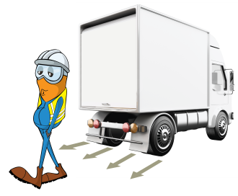
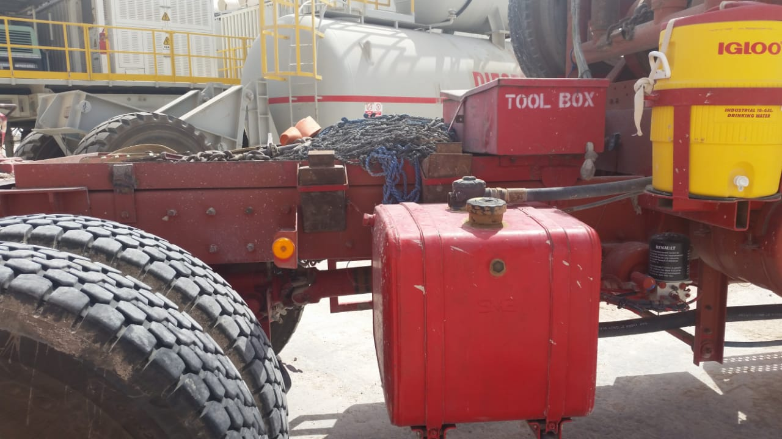
PDO Incident First Alert
Incident type | LTI (#20)
Date/ time | 20.07.18 @ 17:45 hrs | Directorate
Location | Rig 75 – Qarn Alam | Dept
What happened
Whilst the helper was returning wheels chocks into their brackets, the prime mover moved forward causing the wheels to strike the helper resulting in multiple fractures.
Mr. Musleh asks the questions of can it happen to you?
Do you ensure you communicate with the driver before attending a vehicle?
Do you ensure you check around the vehicle before moving?
Do you ensure you are out of the “Line of Fire”?
Position of the helper whilst placing the chocks into storage brackets.
Please disseminate this LTI notification to your teams and use it in your tool box talks and HSE meetings and notice boards.

