Slide 1
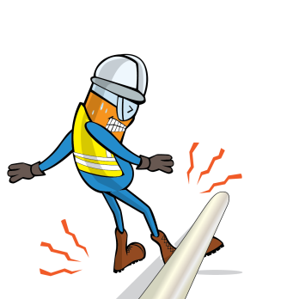
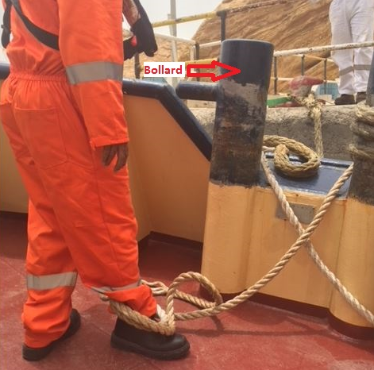
PDO Incident First Alert
Incident type | LTI (#21)
Date/ time | 21.07.18 @ 01:15 hrs | Directorate
Location | Mina Al Fahal Terminal | Dept
What happened
During the process of connecting the mooring rope, the Able Seaman’s leg was caught up by the rope resulting in a fracture to his right leg.
Mr. Musleh asks the questions of can it happen to you?
Do you ensure you are in a safe location?
Do you ensure all hazards are identified before performing the task?
Do you ensure you are out of the “Line of Fire”?
Please disseminate this LTI notification to your teams and use it in your tool box talks and HSE meetings and notice boards.

