Slide 1
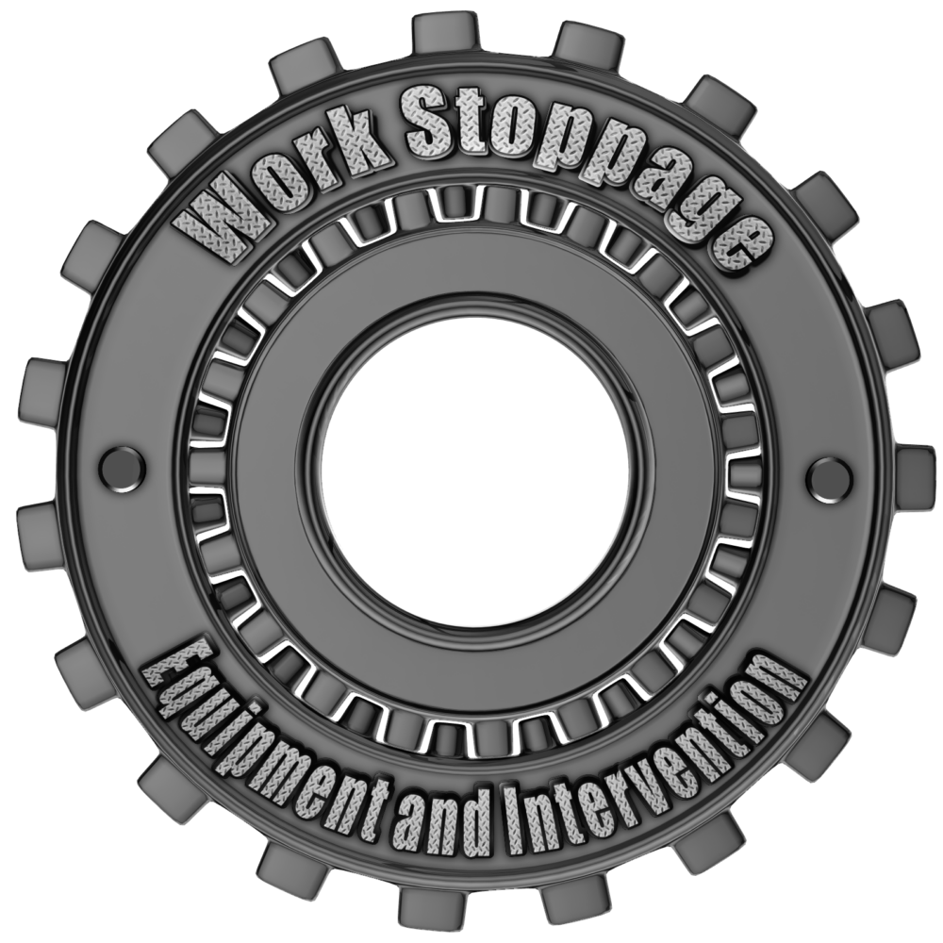
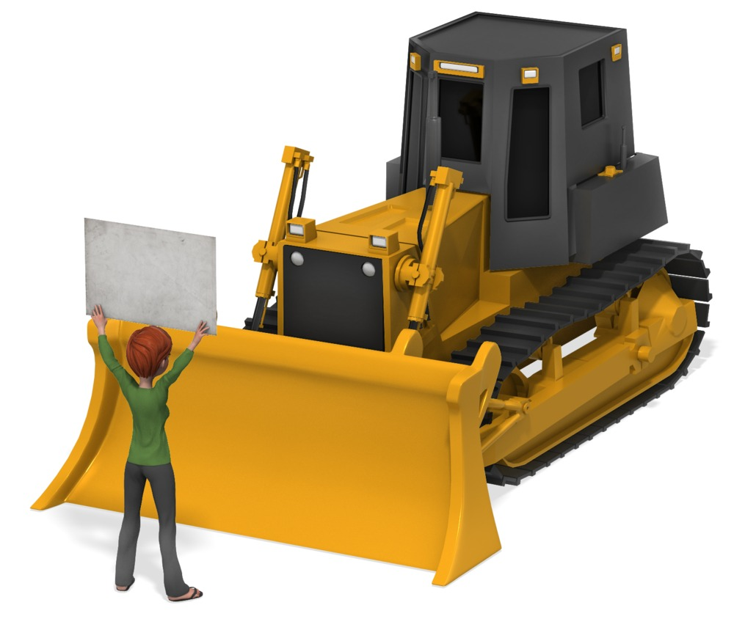
Work Stoppage – Equipment & Intervention
Notes:
The reason for this work stoppage is to highlight the fact that PDO and its contractors continue to suffer from a high number of preventable incidents, the majority of which could be avoided!

Slide 2
Incidents Year to date
2 Fatalities
22 LTI’s (Lost Time Injuries)
11 NAD’s (None Accidental Deaths)
28 HiPo’s (High Potential Incidents)
Will you be next?
Notes:
Ask the attendees:
Why they think still we have this incidents……………there is no right or wrong answers, it is more about engagement
DON’T BE THE NEXT VICTIM!
Instead of repeating the mistakes, try doing the right thing and this will become your habit.

Slide 3
What does this picture say to you?
Notes:
The reason for this work stoppage is to highlight the fact that PDO and its contractors are still not learning from incidents, the majority of which could be avoided!
Emphasise this is about learning from incidents.
Can you stop a vehicle like this?

Slide 4
Do you look behind you every time you reverse?
Notes:
Ask the following questions:
Where / who is my Banksman?
Can reversing be avoided?
What turns are needed?
Where will the vehicle be going?
Are there obstructions?
Will there be any blind spots/areas?
Are there pedestrian walk ways?

Slide 5
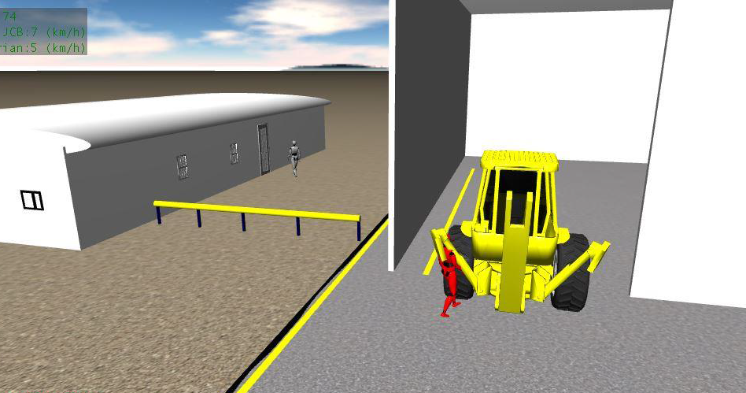
Fatality
Can you see and be seen?
Task fabrication workshop activities
Tool carrier was parked inside the fabrication workshop.
Plant storekeeper walked behind the tool carrier
Tool carrier operator reversed out of the workshop unnoticed the Plant storekeeper
The Tool carrier hit the Plant storekeeper and run over causing a serious injures to his left leg
Notes:
Where should you walk when vehicles are in the area?
What could happen?

Slide 6
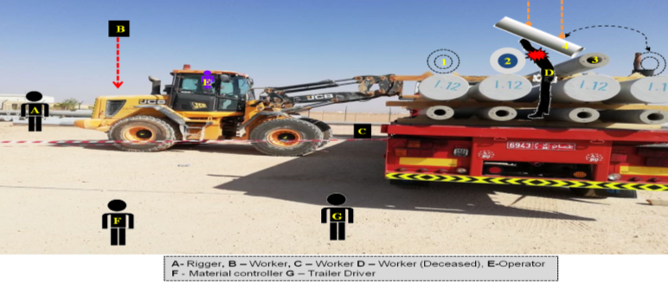
Fatality
Is this the safest place to stand during unloading?
Task unloading concrete posts
Tool carrier used to unload poles, two crew members climbed onto the trailer
Material controller and driver of the truck stood behind the trailer watching the activity.
The worker (C) moved to the front of the vehicle whilst the other (D) stood between poles 2 and 3 in the centre and rear dunnage.
As the operator began to lift the load, the sling slipped causing the pole to swing towards worker D crushing him between the lifted pole (4) and the 2 pole.
The pole hit worker D from behind crushing his chest against pole 2 resulting in a crush injury.
Worker D was trapped between the 2 poles until the load was lifted from him.
Notes:
Have you seen similar situations in the work place?
What should you do?
Who can stop the job and who starts it again?

Slide 7
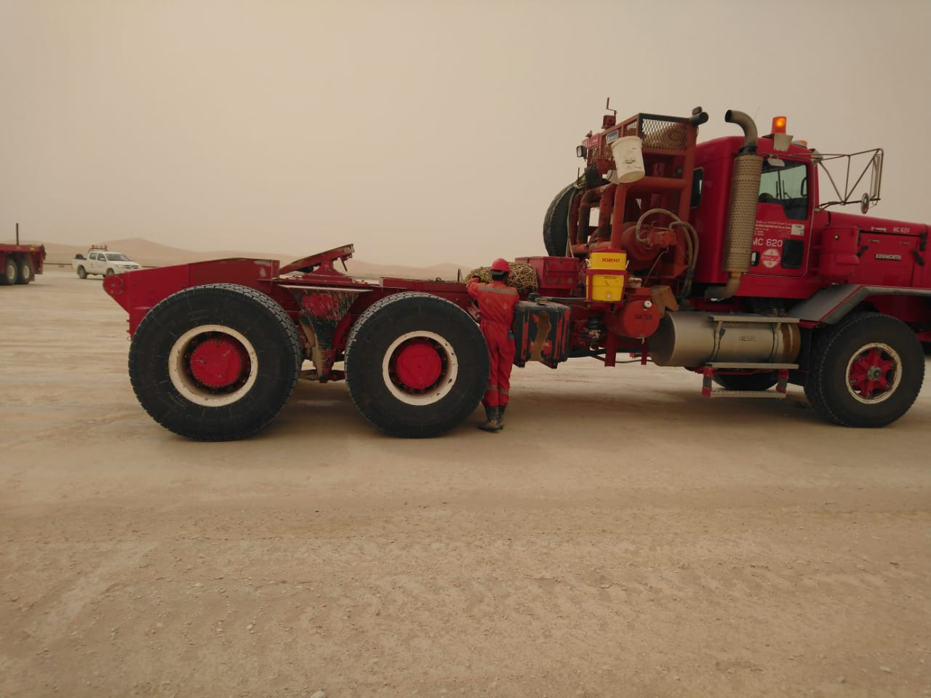
Broken legs
Are you in the danger zone?
Rig Move
Helper is standing between front most rear wheels and hydraulic oil tank, whilst placing wheel chocks back in to storage brackets
Rig equipment does not have its own chocks
Driver and helper did not communicate clearly with each other
The driver moved forward after the helper went into the blind spot
The impact from the wheels knocked the helper down and the 1st axle wheels went over him crushing his legs
Notes:
Ask what does LINE Of FIRE mean to you?
Can you identify Line of Fire in the photo?
Answer:
The zone within a work area where there is risk of injury from machinery, equipment or any source of energy

Slide 8
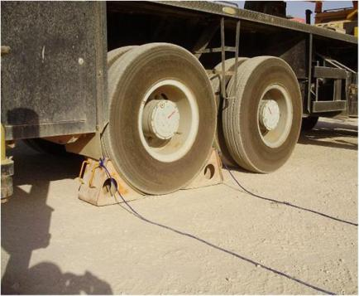
Fatality
Always use wheel chocks with ropes on parked heavy plant / equipment.
Task welding pipe line
A Welder head crushed between 36” pipe and moving (rolling) Crane.
Root Causes:
Inconsistent working of Crane’s parking brake (brake failed / did not work).
Quality control on maintenance of hired plant/equipment non-existent.
Lateral Learning:
Parking brakes are not 100% fool proof.
Notes:
Ask what does LINE Of FIRE mean to you?
Can you identify Line of Fire in the photo?
Answer:
The zone within a work area where there is risk of injury from machinery, equipment or any source of energy

Slide 9
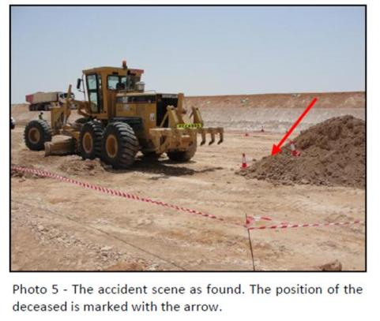
Fatality
Tool Box Talks need to be customised and effective for highly repetitive work
Grader operation
A Trip Load Counter was run over by a maneuvering grader
The grader operator failed to properly observe the rear view mirrors and over shoulder check prior to reversing
The desceased was positioned in an unsafe area behind the maneuvering grader
Using rear view mirrors must always be supported by shoulder views for plant and heavy equipment operators
For highly repetitive work, tool box talks were found to be ineffective
Clear definition of minimum safe distance from heavy equipment is required
Notes:
Ask what does LINE Of FIRE mean to you?
Can you identify Line of Fire in the photo?
Answer:
The zone within a work area where there is risk of injury from machinery, equipment or any source of energy

Slide 10
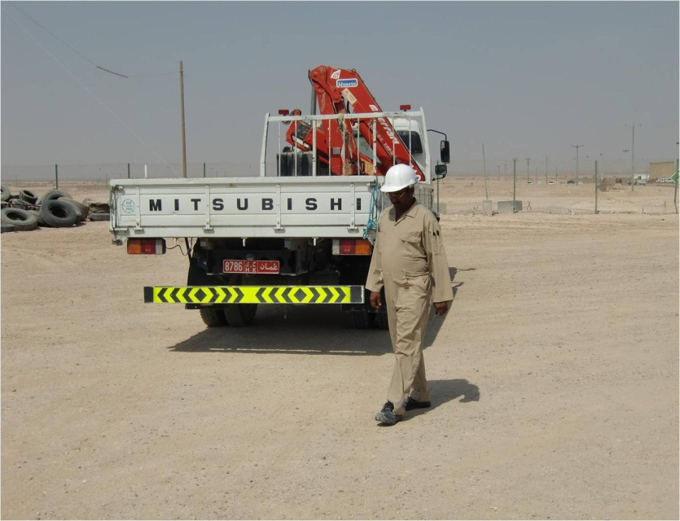
Fatality
All reversing is hazardous. Keep it safe !!
A Hiab whilst reversing down a road under construction ran over the foreman.
Heavy Goods Drivers
Always use a banksman to reverse
If in doubt stop
Rushing causes mistakes
No place is low risk
Pedestrians
Never walk behind a reversing vehicle
Never assume you have been seen
Intervene safely if you do not see a banksman
Always pay attention
Notes:
Ask what does LINE Of FIRE mean to you?
Can you identify Line of Fire in the photo?
Answer:
The zone within a work area where there is risk of injury from machinery, equipment or any source of energy

Slide 11
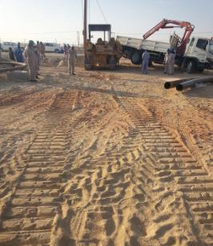
Fatality
It’s best to seek help and share a problem than to keep it to yourself.
The crew finished their days work laying a flowline and the operator parked the side boom crane.
Stress is not what happens to us, it is more about our response to what happens
Our company will try and help you if you have personal problems, so share them and seek help?
To look out for your work colleagues especially if you notice a change in their behavior?
Notes:
Ask what does LINE Of FIRE mean to you?
Can you identify Line of Fire in the photo?
Answer:
The zone within a work area where there is risk of injury from machinery, equipment or any source of energy

Slide 12
Don’t be the next victim!
Are you in the line of fire?
“THE ZONE WITHIN A WORK AREA WHERE THERE IS RISK OF (SERIOUS) INJURY FROM MACHINERY OR EQUIPMENT”
Are you working with or near vehicles and machinery ?
What is my role as supervisor and how can I avoid such incidents ?
Notes:
Ask what does LINE Of FIRE mean to you?
Can you identify Line of Fire in the photo?
Answer:
The zone within a work area where there is risk of injury from machinery, equipment or any source of energy
Explain with short description each possible source of energy with some examples:
1. Mobile Heavy Equipment
2. Hoisting & Lifting
3. Dropped Objects
4. Tensioned Lines/Devices
5. Objects with roll/fall potential
6. Pressurized Equipment
7. Machinery & Tools
8. Electrical Equipment
9. Projectiles
10. Pushing & Pulling

Slide 13
Discussion
Do you always look out for your work colleagues to keep everyone safe?
Do supervisors always ensure staff are supervised at all times?
Do you have personal problems that you need to share and seek help?
Do you ensure your equipment is isolated when there is no operator in the seat?
As a banksman, when do you stop helping a driver?
Notes:
Discuss these incidents with the team and reflect on what you will do differently tomorrow

