Slide 1
Safe Driving During Eid Holidays
You are responsible for their smile!

Slide 2
Safe driving behaviors
Getting adequate rest prior to any trip to avoid fatigue.
Performing vehicle pre trip inspection (Tyre, lubricants, coolant, belts, battery, lightning…etc).
Check around the vehicle before moving,
make sure it’s free from children or other obstacles.
Wearing safety belt and ensuring passengers do so.
Complying with safe driving speed limits.
Stopping vehicle while using mobile phone.
Keeping safe distance on the road.
Remaining alert and respecting other road users.

Slide 3
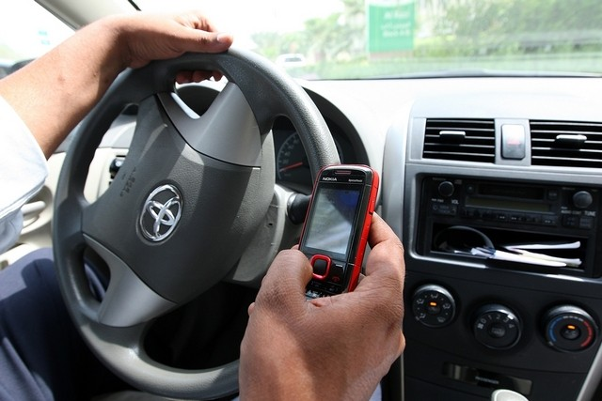
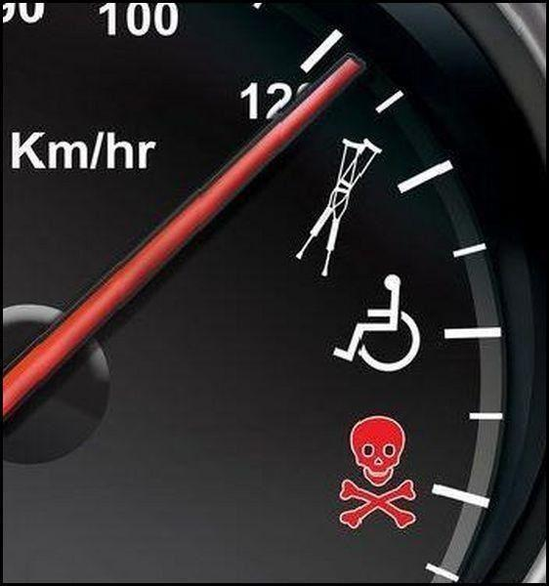
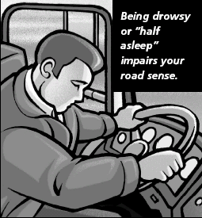
Basic Causes of Accidents During Eid
Mobile Phones
Over speed
Fatigue

Slide 4
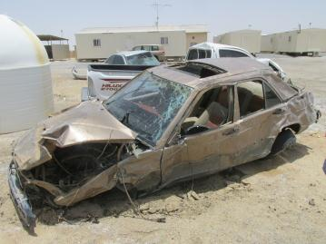
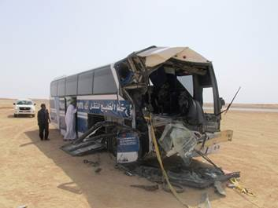
Major Cause of Road Accidents
Fatigue
Over-speeding
Learn from others’ mistakes and do not repeat them!
Take enough rest before driving and pay attention while driving for your own safety and the safety of the others.
Speeding

Slide 5
Remember that ..
Your behavior influences your risk management on the road – You are in control.

