Slide 1
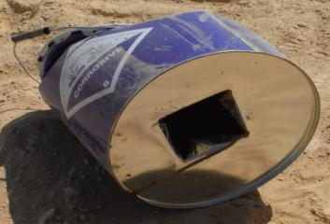
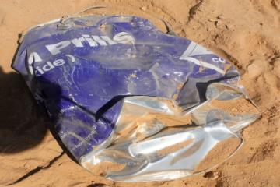
PDO Second Alert
Date: 30th January 2018 Incident title: Chemical Burns
What happened?
The Assistant Driller (AD) identified a leak on a hose that was difficult to reach, he asked a Roustabout (RA) to bring ‘something’ to stand on. The RA fetched an empty Caustic Soda drum (used and punctured from below) from the top of the tank and started walking towards the stairs. While passing over the walkway grating above, the AD who was standing below looked up. Residue of the Caustic Soda powder fell from the bottom drum onto the AD’s face resulting in chemical burns to his right eye and cheek.
Your learning from this incident..
Always ensure staff are adequately trained for the job
Always ensure all chemical containers / sacks are disposed of properly after use
Always ensure you use the right tools for the job
Always ensure hazards are identified prior to starting a task
Always ensure hazards are communicated prior to starting a task
Photo explaining what was done wrong
Photo explaining how it should be done right
Ensure all empty Caustic Soda drums are crushed and disposed of properly and immediately!

Slide 2
Management self audit
Date: 30th January 2018 Incident title: Chemical Burns
As a learning from this incident and to ensure continual improvement all contract
managers must review their HSE HEMP against the questions asked below
Confirm the following:
Do you ensure all hazards associated with the disposal of chemical containers are identified and shared?
Do you ensure your supervisors follow the correct practices?
Do you ensure appropriate training is provided to all, and staff are intervening effectively?
Does management perform audits as per approved schedule? Do they assure compliance to rules and regulations?
Notes:
Make a list of closed questions (only ‘yes’ or ‘no’ as an answer) to ask other contractors if they have the same issues based on the management or HSE-MS failings or shortfalls identified in the investigation. Pretend you have to audit other companies to see if they could have the same issues.

