Slide 1
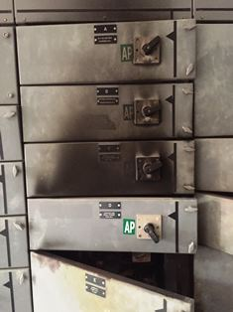
PDO Second Alert
Date: 03/02/18 LTI - Electrical Flash Over
What happened?
An Electrician isolated the 415v panel and checked the fuses, he found they were in open circuit. The fuses were replaced, and on energising the circuit, the electrician noticed there were sparks coming from the cable connection on fuse holder.
Without isolating the panel the Electrician then removed the fuses and using a non insulated 4mm Allen key he attempted to tighten the cable on the live side, during this operation the Allen key touched the lower metal shelf causing a short circuit and electrical explosion.
Your learning from this incident..
Permit to work systems must be followed and checked by management
Communicate effectively and do not make assumptions
Good supervision must be in place
Restricted areas must only be accessed by authorised persons
Working on energsed electrical systems must only be done by competent persons
Hand tools must be inspected on a regular basis to ensure they are safe to use
TBT must be carried out and recorded
Staff must intervene and stop unsafe work
Staff must follow Life Saving Rules
Follow the rules to save a life

Slide 2
Management self audit
Date: 03/02/18 Incident title: Electrical Flash Over
As a learning from this incident and ensure continual improvement all contract
managers must review their HSE HEMP against the questions asked below
Confirm the following:
All access to restricted areas is controlled with PTW as per PR1172?
Adequate and competent supervision in place for high risk activities, and that CEP authorized persons are readily available to comply with PDO ESR?
All staff have a good awareness and comply with the PTW process?
All staff understand the hazards and consequences of working on Energized Electrical Equipment?
All staff are fully aware of what to do in an emergency situation and are aware of the PDO emergency numbers?
Notes:
Make a list of closed questions (only ‘yes’ or ‘no’ as an answer) to ask other contractors if they have the same issues based on the management or HSE-MS failings or shortfalls identified in the investigation. Pretend you have to audit other companies to see if they could have the same issues.

