Slide 1
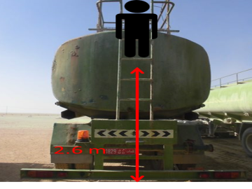
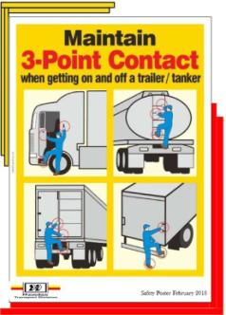
PDO Second Alert
Date: 10th February Incident title: LTI
What happened?
At Approximately 14:15 hrs. On 10th February 2018, a Heavy Duty Driver of a sub-contractor was descending from the brine water tanker at the water well. His foot slipped off from the third step of the rear ladder of the brine tanker, approximately 2.6 meters height from the ground level. The driver had a fall and landed on his feet causing fracture.
Your learning from this incident..
Ensure safety briefing is given to drivers on climbing water tankers as they have to work at remote locations (lone working)
Always watch your steps whilst using ladders
Ensure third party drivers participate in TBTs and relevant alerts are communicated to them
Ensure 3 point contact maintained whilst using ladder

Slide 2
Management self audit
Date: 10th February Incident title: LTI
As a learning from this incident and to ensure continual improvement all contract managers must review their HSE HEMP against the questions asked below
Confirm the following:
Do you ensure drivers know about maintaining 3 point contact ?
Do you ensure adequate controls for lone workers?
Do you ensure ladder of the tanker has anti-slippery grating?
Notes:
Make a list of closed questions (only ‘yes’ or ‘no’ as an answer) to ask other contractors if they have the same issues based on the management or HSE-MS failings or shortfalls identified in the investigation. Pretend you have to audit other companies to see if they could have the same issues.

