Slide 1
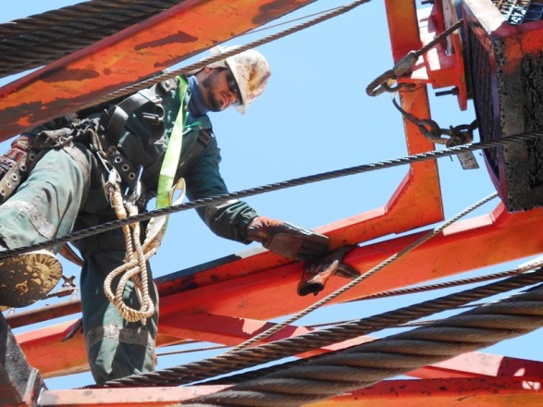
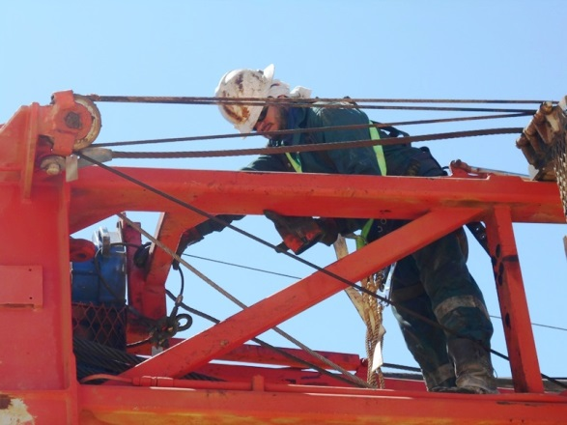
PDO Second Alert
Date: 13-02-2018 Finger Crush Injury
What happened?
While installing a new winch line a Roustabout (RA) was helping the Derrick man to guide the sling into place. As the RA moved into position the fall arrestor post failed resulting it in folding down crushing his left hand index finger.
Your learning from this incident..
Always ensure you keep hands away from pinch point area
Ensure effective preventive maintenance in place for all the equipment
Ensure SOP available for all non-routine tasks
Always ensure adequate supervision
Ensure all hazards are identified prior to the task
Ensure using proper and required PPE for the task (use empowerment to STOP work if the required PPE is not available)
Do not stand in line of fire or in between moving parts (Fall arrestor post in upright position)
Always ensure fall arrestor post in folded position before working in mast and stay away from line of fire
Always stay out of the line of fire

Slide 2
Management self audit
Date: 13/02/2018 Finger Crush Injury
As a learning from this incident and to ensure continual improvement all contract managers must review their HSE HEMP against the questions asked below
Confirm the following:
Do you have PMS in place related to all equipment or moving parts (Fall Arrestor Damping unit)?
Do you have pre-Rig/Down checklist which includes function test of damping unit?
Do you have SOP for installation of new winch line in rig down position?
Do you ensure your teams are aware of all the hazards and risk mitigation during your Tool Box Talks?
Do you have right procedure for working at height and emergency evacuation from height?
Do you have enough full body harness at site and maintained in good condition?
Do you ensure pinch point register is kept up to date?
Notes:
Make a list of closed questions (only ‘yes’ or ‘no’ as an answer) to ask other contractors if they have the same issues based on the management or HSE-MS failings or shortfalls identified in the investigation. Pretend you have to audit other companies to see if they could have the same issues.

