Slide 1
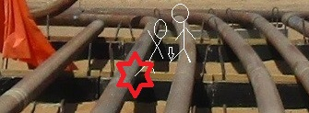
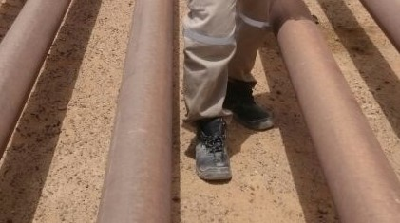
PDO Second Alert
Date: 20-03-2018 Incident title: LTI #07
What happened?
While the supervisor was crossing parallel pipes, he slipped loosing his balance fall and trapped between pipes hitting his head on the concrete sleeper. He suffered a cut in the head and a fracture in the right leg.
Your learning from this incident..
Always use the correct access to cross pipe lines
Ensure TRIC been used effectively
Always plan your activity and prioritise your work
Always intervene at unsafe acts or conditions and report regardless of designation
Never walk on pipe lines
Do not stand in the ‘Line of Fire’
Identify the hazards of your job

Slide 2
Management self audit
Date: 20-03-2018 Incident title: LTI #07
As a learning from this incident and to ensure continual improvement all contract managers must review their HSE HEMP against the questions asked below
Confirm the following:
Do you assign competent staff to all activities?
Does your HEMP cover all the hazards involved in each task?
Do you ensure your TBT covers all associated hazards for the activity?
Do you empower your team to stop unsafe act/condition?
Do you ensure that the correct access is always used when working with pipe lines?
Notes:
Make a list of closed questions (only ‘yes’ or ‘no’ as an answer) to ask other contractors if they have the same issues based on the management or HSE-MS failings or shortfalls identified in the investigation. Pretend you have to audit other companies to see if they could have the same issues.

