Slide 1
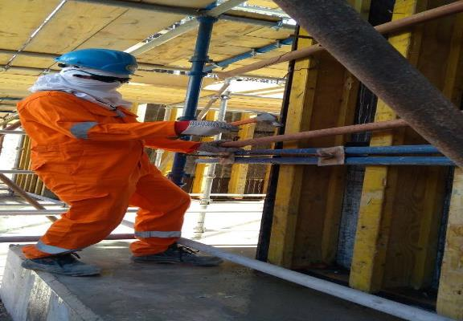
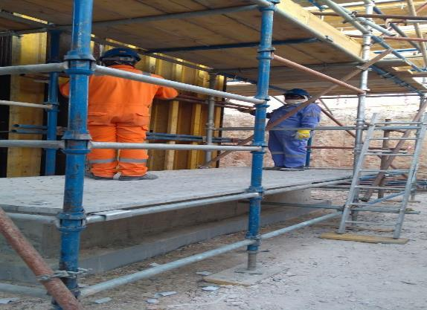
PDO Second Alert
Date: 24.03.2018 Incident title : LTI #08
What happened?
While a shuttering carpenter was doing de-shuttering of the pump foundation shutter by hammer to loosen the tie-rod’s wing’s plate, one of the bracing pipe (Scaffold tube) fallen on his left hand after it became free and resulted fracture on his left ring finger.
Your learning from this incident..
Always ensure minimum two people engaged for fixing/removing pedestal bracing pipes (Scaffold tube)
Always ensure sufficient platform/space for standing employees for the work
Always ensure removing binding wire tie after loosening of the tie-rod wing’s nut
Always ensure using heavy duty hand gloves for shuttering/de-shuttering activities.
Intervene if not safe and increase number of STOP/SPOT interventions
Always assess the risks, Stop and think.

Slide 2
Management self audit
Date: 24.03.2018 Incident title : LTI #08
As a learning from this incident and to ensure continual improvement all contract managers must review their HSE HEMP against the questions asked below
Confirm the following:
Do you ensure the crew is aware of all the hazards involved in the work?
Do the supervisors continuously monitor the site activities?
Do you ensure crew are issued with and use right PPE for the job?
Do you encourage intervention culture amongst your workforce ?
Do you consider complacency as a risk factor for your workforce doing routine activities ?
Do you provide correct work platforms for working at height?
Notes:
Make a list of closed questions (only ‘yes’ or ‘no’ as an answer) to ask other contractors if they have the same issues based on the management or HSE-MS failings or shortfalls identified in the investigation. Pretend you have to audit other companies to see if they could have the same issues.

