Slide 1
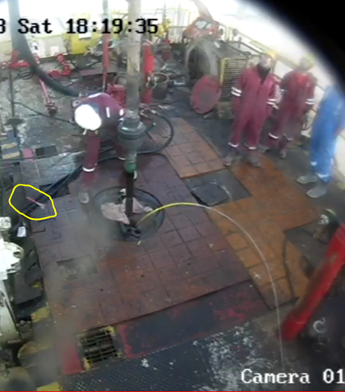
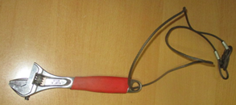
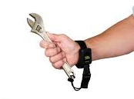
PDO Second Alert
Photo from CCTV
Date:17.02.18 Incident title : High Value Learning
What happened?
Adjustable spanner weighing 450 grams, fell from 18 meters height to the rotatory area, while the Derrickman was tightening a hydraulic hose below the monkey board. A third party employee was working on the tubing hanger in rotary area at the time of incident close to where the spanner landed. No Injury or Damage from this incident.
Your learning from this incident..
Coordinate with supervisor (area authority) prior to start any task
Always use tethered tools while working at height and ensure it is recorded in the register
All non routine work at height shall be under PTW
Always ensure zone management is strictly followed
Dropped spanner
Use certified tethered tools while working at height
Adequate tethered tools

Slide 2
Management self audit
Date:17.02.18 Incident title : High Value Learning
As a learning from this incident and to ensure continual improvement all contract managers must review their HSE HEMP against the questions asked below
Confirm the following:
Do you ensure staff use tethered tools and recorded in the temporary tools register while working at height?
Do you ensure staff use the audit to identify the behaviors while working at heights?
Do you ensure staff use of PTW while working at heights?
Do you ensure staff identify the hazards and risks related to working at heights and capture in the TBT with TRIC?
Do you use CCTV to monitor red zone management at the site?
Do you ensure risk assessment performed and controls implemented while simultaneous operations?
Notes:
Make a list of closed questions (only ‘yes’ or ‘no’ as an answer) to ask other contractors if they have the same issues based on the management or HSE-MS failings or shortfalls identified in the investigation. Pretend you have to audit other companies to see if they could have the same issues.

