Slide 1
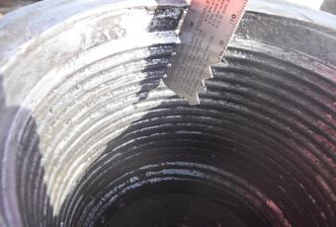
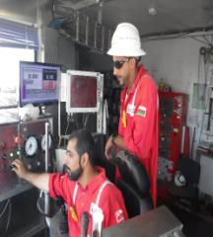
PDO Second Alert
Date: 26th Jan,2018 Incident title: Dropped Object Incident-HiPo
What happened?
While the driller was working on the 18 5/8” differential stuck casing, the water bushing box end 300 kg came off from TDS (Top Drive System) crossover sub, causing the casing to drop 8 metres, striking the side door elevator, causing coupling to come off from casing.
Your learning from this incident..
Always ensure correct equipment (Spider Elevator) is used for the task
Ensure clear communication among all supervisors and staff prior to starting critical operation.
Always ensure visual inspection of threaded equipment prior to use
Always ensure red zone controls are implemented
Photo explaining what was done wrong
Photo explaining how it should be done right
Always ensure full supervision during critical operation

Slide 2
Management self audit
Date: 26th Jan,2018 Incident title: Dropped Object Incident-HiPo (EQD)
As a learning from this incident and to ensure continual improvement all contract managers must review their HSE HEMP against the questions asked below
Confirm the following:
Do you ensure that your site personnel are aware if the equipment used is fit for purpose?
Do you ensure that site personnel communicate with head office for any abnormal activity?
Do you ensure third party inspection cover all third party equipment ?
Do you ensure management of change is in place for any change in PSP?
Do you verify full understanding of written work instructions including the operating limits?
Notes:
Make a list of closed questions (only ‘yes’ or ‘no’ as an answer) to ask other contractors if they have the same issues based on the management or HSE-MS failings or shortfalls identified in the investigation. Pretend you have to audit other companies to see if they could have the same issues.

