Slide 1
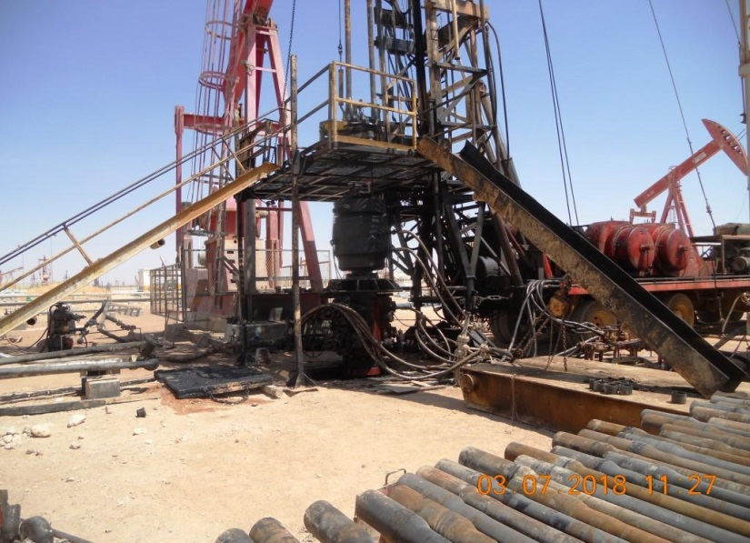
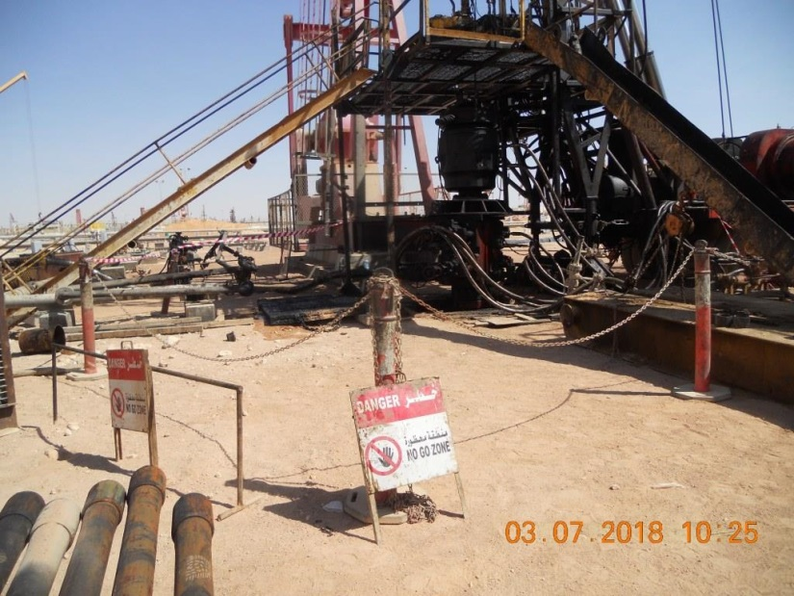
PDO Second Alert
Date: 14.02.18 NM – Dropped Handrail section
What happened?
On 14th of February 2018 at 11:00hrs the operation was rigging up hoist floor, the Floorman was installing a section of the handrail on the Driller’s side of the hoist floor when he put the handrail on the bracket the handrail slipped from his hand and fall down to the ground from a height of 2.5 meters, a crew member was standing within 2.5 meters of the dropped handrail impact point.
Your learning from this incident..
Always ensure “no go” zone are set up and communicated
Always ensure your PPE is in good condition
Always ensure SIMOPs are included in your TBTs
Always ensure hazards are identified in your task risk assessments
no go zone not installed
Always ensure “no go” zone are in place
no go zone installed

Slide 2
Management self audit
Date: 14.02.18 NM – Dropped Handrail section
As a learning from this incident and to ensure continual improvement all contract managers must review their HSE HEMP against the questions asked below
Confirm the following:
Do you ensure a temporary “no go” zone is installed during rig up/rig down?
Do you ensure hand rails are installed under a PTW?
Do you ensure risk assessments cover all hazards and controls?
Do you identify potential DROPS hazards and have mitigations in place?
Notes:
Make a list of closed questions (only ‘yes’ or ‘no’ as an answer) to ask other contractors if they have the same issues based on the management or HSE-MS failings or shortfalls identified in the investigation. Pretend you have to audit other companies to see if they could have the same issues.

