Slide 1
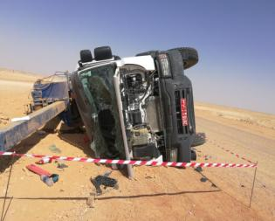
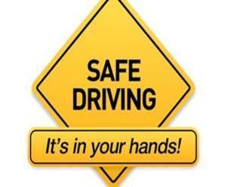
PDO Second Alert
Date: 27 January 2018 High Potential MVI in Bahja
What happened?
A pole hole drill rig vehicle skidded and rolled over while negotiating a curve on the graded road near Sadad station towards Hubara. The driver lost control over the vehicle when the right wheels touched gravel on the right shoulder of the road. The driver and helper were transported to PDO clinic in Rima; they both were unharmed.
Your learnings from this incident:
Always drive to the road conditions
Always keep a reasonable distance between your vehicle and road shoulder
Always slow down when approaching a sharp bend on a graded road – even if a speed limit sign is not there
Always drive to the road conditions!

Slide 2
Management self audit
Date: 27 January 2018 High Potential MVI in Bahja
As a learning from this incident and to ensure continual improvement all contract managers must review their HSE HEMP against the questions asked below
Confirm the following:
Do you ensure all drivers are properly trained, competent and experienced enough to drive on graded roads at remote areas?
Do you ensure you communicate efficiently with your sub-contractors on their work plans and journey management arrangements?
Do you follow approval protocol for all drivers and vehicles of your sub-contractors?
Do you ensure your sub-contractors are aware who is a focal point of contact for them in your organisation?
Do you ensure you properly cascade incident learnings among your sub-contactors?
Notes:
Make a list of closed questions (only ‘yes’ or ‘no’ as an answer) to ask other contractors if they have the same issues based on the management or HSE-MS failings or shortfalls identified in the investigation. Pretend you have to audit other companies to see if they could have the same issues.

