Slide 1
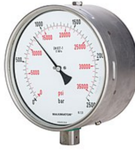
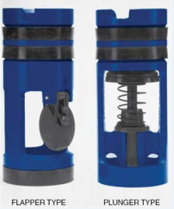
PDO Second Alert
Date: 15.01.18 Incident HiPo#05
What happened?
A high pressure kick was taken whilst attempting to mill a restriction in the 4 ½” liner on Sakhiya 44. There were no floats in the string and the TDS was positioned a full stand above the rotary table. The topdrive upper (hydraulic) IBOP valve was closed when the drillpipe pressure was 4,000psi but did not seal. The standpipe pressure eventually stabilised at 5,844psi. It was not possible to generate enough torque to close the manual IBOP at height from the manrider. The well was killed with the wait and weight method. The contingency plan was to shear the string if the standpipe started leaking.
Your learning from this incident..
Run float valves in all BHAs.
A manual IBOP requires very high torque (7kftlbs) to close with 10kpsi internal pressure. Spaceout the TDS to be at an accessible height when milling so that if required this high torque can be applied to the manual IBOP.
Include a kelly cock just above the rotary table when conducting “at-risk” operations i.e. perforations / milling / displacing to lower fluid weights.
High zinc content IBOPs are not compatible with high chloride (salt) mud environments as dezincification can rapidly occur.
If a restriction is observed in the casing / liner run slickline drifts and e-line logs to understand the cause of the restriction before swedging or milling.
5000 PSI
Float valves not installed.
Unable to break out string and install kelly cock against high pressure.
Run float valves in all BHAs.
Run float valves on all strings.

Slide 2
Management self audit
Date: 15.01.18 Incident HiPo#05
As a learning from this incident and to ensure continual improvement all contract
managers must review their HSE HEMP against the questions asked below
Confirm the following:
Do you have procedures that cover all operations including well control requirements?
Do you have a bridging document?
Do the procedures mandate running float valves in all assemblies?
Do you have a process for ensuring pressure control equipment is compatible with the planned fluid environment?
Notes:
Make a list of closed questions (only ‘yes’ or ‘no’ as an answer) to ask other contractors if they have the same issues based on the management or HSE-MS failings or shortfalls identified in the investigation. Pretend you have to audit other companies to see if they could have the same issues.

