Slide 1
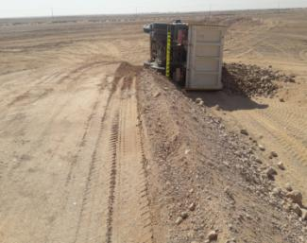
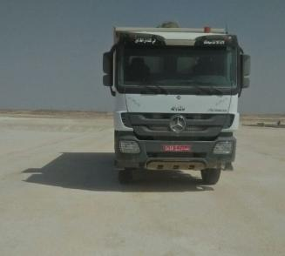
PDO Second Alert
Date: 20.01.2018 Incident title: MVI
What happened?
On 20th January 2018 at around 11:20 am at Yibal, the driver was driving the tipper partially loaded with soil at the right side of the ongoing worksite to unload it near the runoff. He travelled approximately 200 meter from the loading point and while descending the ramp the vehicle toppled through the loose soil.
Your learning from this incident..
Always keep a safe distance from the roadway
Always ensure equal and balanced load
Always review drivers records and that they are fit to work
Always ensure the workforce are not being
Safe distance from the edge
Maintain a safe distance while driving

Slide 2
Management self audit
Date: 20.01.2018 Incident title: MVI
As a learning from this incident and to ensure continual improvement, all contract managers must review their HSE HEMP against the questions asked below:
Confirm the following:
Do you ensure that new/young drivers are adequately mentored prior to assigning the task?
Do you ensure daily that all drivers are fit to work?
Do you have a formal system to monitor the driver’s behaviour other than IVMS?
Do you ensure the site are adequately laid out and all controls are in place?
Do you ensure safe access roads are in place?
Notes:
Make a list of closed questions (only ‘yes’ or ‘no’ as an answer) to ask other contractors if they have the same issues based on the management or HSE-MS failings or shortfalls identified in the investigation. Pretend you have to audit other companies to see if they could have the same issues.

