Slide 1
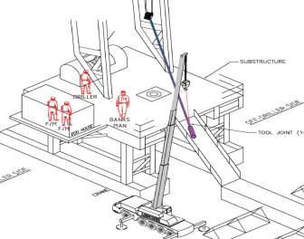
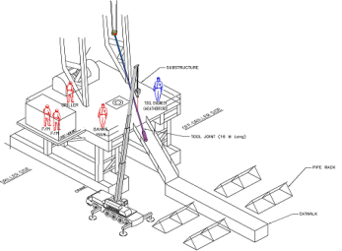
PDO Second Alert
Date: 23-02-2018 Incident title: Asset Damage
What happened?
While laying down 4½” liner running tool (16 Meters length) using crane from V door side and elevator from the rig floor, the R/T got broken at 1.5m height, from the rotary table. One side of the broken tool (weight 300Kg), swung towards the draw works and remained suspended on the Elevator. The other broken part (Weight 55Kg), that came in contact with the rig floor, remained suspended on the crane.
Your learning from this incident..
Always ensure 3rd party supervision is on the drill/work floor while running or laying down any 3rd party tools
Ensure effective two-way communication at all times
Ensure you are authorised to carry out the task
Drillers should not perform any task involving 3rd party tools without clear instructions/confirmation of the Tool Pusher & DSV
Ensure adequate work instructions/TRIC card /Lift plan, to control the work between all parties involved
Tool lifted without adequate supervision
3rd party supervisor
Always ensure 3rd party supervision while handling their 3rd party tools
Ensure adequate third party supervision

Slide 2
Management self audit
Date: 23rd February 2018 Incident: Asset Damage
As a learning from this incident and to ensure continual improvement all contract managers must review their HSE HEMP against the questions asked below
Confirm the following:
Do you ensure work instructions for the tasks involved with 3rd parties?
Do you ensure adequate communication between the third parties ?
Do you ensure instruction are conveyed only through the site in charge/TP?
Do you ensure specific written procedures for handling tools/equipment of 3rd party’s/subcontractors incorporated into the written work instructions and / or available at site?
Notes:
Make a list of closed questions (only ‘yes’ or ‘no’ as an answer) to ask other contractors if they have the same issues based on the management or HSE-MS failings or shortfalls identified in the investigation. Pretend you have to audit other companies to see if they could have the same issues.

