Slide 1
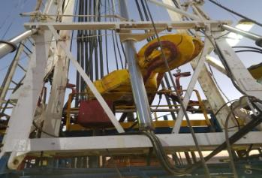
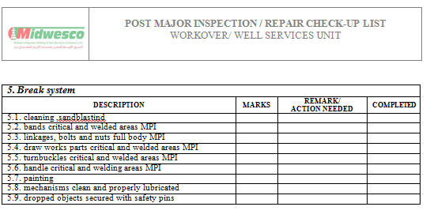
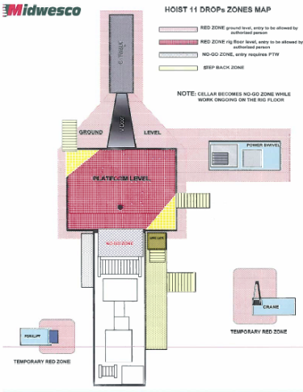
PDO Second Alert
Date: 15th March 2018 Incident title travelling Block HIPO
What happened?
While the operation was RIH 6 1/8" assembly from the mast the Assistant Driller (AD) lost control of the brake due to a malfunction with the braking systems, which resulted in the travelling block falling to the rig floor narrowly missing two employees.
Your learning from this incident..
Ensure adequate supervision while performing tasks
Always STOP the activity if you feel it is unsafe
Always ensure Emergency escape exits are available and installed
Always ensure any mechanical issues are reported to the mechanic immediately
Photo explaining what was done wrong
Always adhere to Red/No Go zones

Slide 2
Management self audit
Date: 15th march 2018 Incident title Dropped travelling Block
As a learning from this incident and to ensure continual improvement all contract managers must review their HSE HEMP against the questions asked below
Confirm the following:
Do you Ensure have QA/QC on services delivered by 3rd parties?
Do you Ensure unit thoroughly inspected after assembling by experienced ML Superintendent?
Do you Ensure Commissioning is commenced on the Third party facility before releasing Unit?
Do you ensure Learning from Incidents captures all potential failures and rectify them?
Do you ensure all emergency equipment is installed prior to start up?
Do you ensure adequate monitoring of your safety management systems?
Notes:
Make a list of closed questions (only ‘yes’ or ‘no’ as an answer) to ask other contractors if they have the same issues based on the management or HSE-MS failings or shortfalls identified in the investigation. Pretend you have to audit other companies to see if they could have the same issues.

