Slide 1
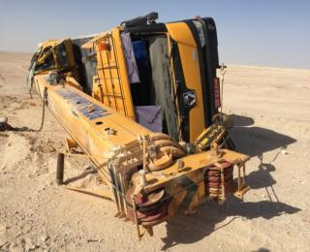
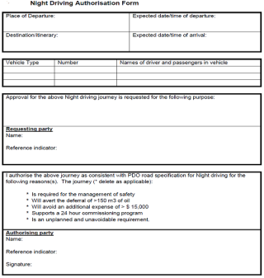
PDO Second Alert
Date: 20.03.2018 Incident title: MVI Rollover
What happened?
Third party crane was mobilised to new location with two crane operators to attend the catwalk trailer breakdown. While returning to the camp after the task, the crane operator failed to locate the turn in the night and applied harsh brake to negotiate the curve. The driver lost control of the crane and rolled over landing on its passenger’s side. The crane driver escaped without injuries while passenger received minor injuries.
Your learning from this incident..
Always ensure any journey requiring night driving has correct authorisation
Identify and assess all the possible hazards/risks related to the night driving
Always ensure strict adherence to the road safety rules/standards during night driving
Ensure effective communication with the Management for non-routine tasks
Identify the hazards & risks involved while executing the crane movements outside the location
Crane rolled over & rested on passenger’s side
while negotiating a curve
Always ensure authorization for night driving

Slide 2
Management self audit
Date: 20.03.18 Incident title: MVI Rollover
As a learning from this incident and to ensure continual improvement all contract managers must review their HSE HEMP against the questions asked below
Confirm the following:
Do you have a system to control vehicle’s movement at the night?
Do you ensure the subcontractor IVMS system complies with PDO requirements including tags?
Do you conduct periodical audits for safe journey management during rig moves?
Do you monitor the compliance of IVMS systems during authorised night driving?
Do you plan your job during the rig move as per the procedures?
Notes:
Make a list of closed questions (only ‘yes’ or ‘no’ as an answer) to ask other contractors if they have the same issues based on the management or HSE-MS failings or shortfalls identified in the investigation. Pretend you have to audit other companies to see if they could have the same issues.

