Slide 1
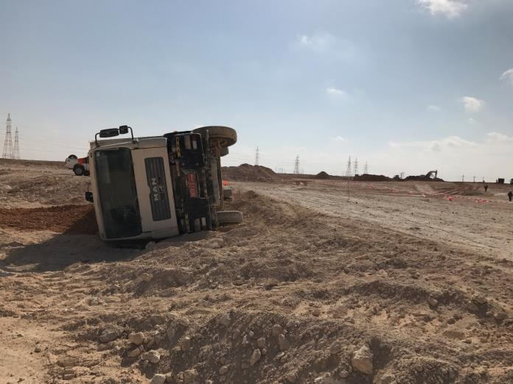
PDO Second Alert
Date: 26.03.2018 Incident: MVI- Hipo # 10
What happened?
While shifting soil from borrow pit to site, driver felt drowsy and decided to drive the vehicle off the road to park. With a blurred vision, he proceeded on to the soft and sloped edge of graded road causing the vehicle to slowly tip over towards the right side. The driver escaped unhurt and reported to clinic for medical check up by medics. This resulted in no injury, but slight damage to tipper.
Your learning from this incident..
Inform Journey Manager regarding your health conditions
Ensure during TBT all employees are healthy to carryout the work
Change in health routines must be done with the advice from approved health practitioners and must be communicated to the company
Always get adequate sleep (6 - 8hrs) before going for work
Driving under fatigue
Diet control plan shall be carried out under proper supervision and advice
Maintain Healthy Diet Along With Good Physical Exercise

Slide 2
Management self audit
26.03.2018: ATE, MVI- Hipo # 10
As a learning from this incident and to ensure continual improvement all contract managers must review their HSE HEMP against the questions asked below
Confirm the following:
Do you ensure daily that all drivers are fit to work?
Do you ensure that new/young drivers are adequately mentored prior to assigning the task?
Do have a formal system to monitor the driver’s behaviour other than IVMS?
Do you ensure the health condition of the employee before assigning task?
Do you have proper key management system?
Notes:
Make a list of closed questions (only ‘yes’ or ‘no’ as an answer) to ask other contractors if they have the same issues based on the management or HSE-MS failings or shortfalls identified in the investigation. Pretend you have to audit other companies to see if they could have the same issues.

