Slide 1
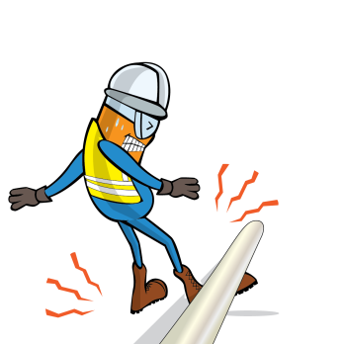
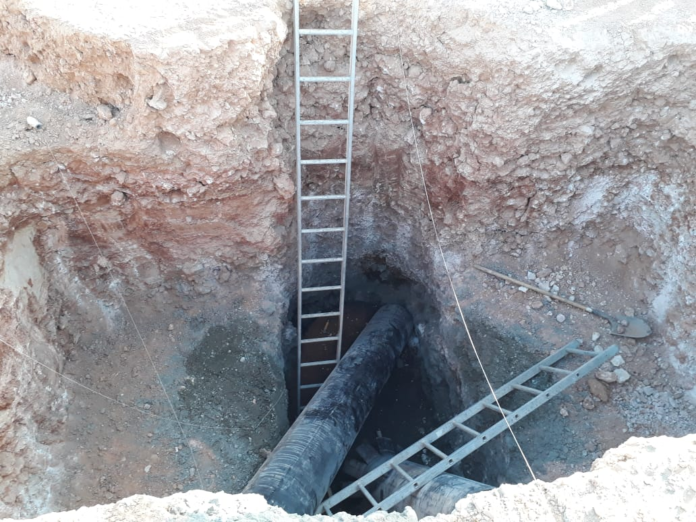



PDO Incident First Alert
Incident type | LTI (#23)
Date/ time | 13.09.18 @ 15:40 hrs | Directorate
Location | Marmul – Raheeq B | Dept
What happened
While the cellar construction crew were aligning the mouse pipe manually in the cellar pit, the pipe slid down and struck the right leg of the mason who was inside the pit at the time. He was taken by ambulance to PDO Marmul clinic for treatment before being referred to Salalah hospital where he was diagnosed with a compound fracture of the right leg.
A
C
Mr. Musleh asks the questions of can it happen to you?
B
Do you ensure you have the right equipment for the task?
Do you ensure that you are stood in a safe place?
Do you ensure all hazards are identified before performing the task?
Do you ensure you are out of the “Line of Fire”?
A- Mason , B – Shuttering Carpenter, C – Steel fixer
Please disseminate this LTI notification to your teams and use it in your tool box talks and HSE meetings and notice boards.

