Slide 1
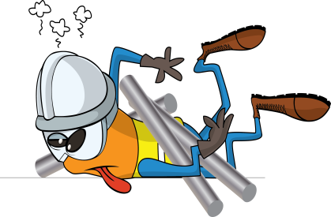
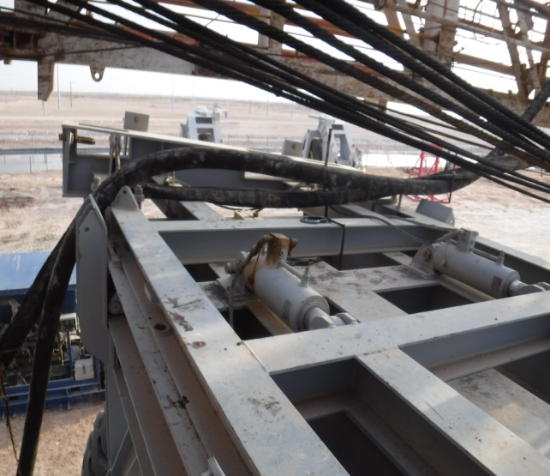
PDO Incident First Alert
Incident type | LTI (#24)
Date/ time | 15.10.2018 @ 18:00 hrs | Directorate
Location | Saih Rawl | Dept
What happened
While preparing for a rig move, the Derrickman was working on the Dolly to connect the mast when the Kelly hose fell hitting him on the shoulder knocking him against a beam injuring his right leg. He was taken to the rig clinic for first aid before being transferred to Nizwa Hospital where he was diagnosed with a fracture of the right leg.
Mr. Musleh asks the questions of can it happen to you?
Do you ensure all hoses are adequately secured during rig moves?
Do you ensure all hazards are identified before performing the task?
Do you consider if you are in the ‘line of fire’?
Kelly hose fell on to Derrickman’s leg
Please disseminate this LTI notification to your teams and use it in your tool box talks and HSE meetings and notice boards.

