Slide 1
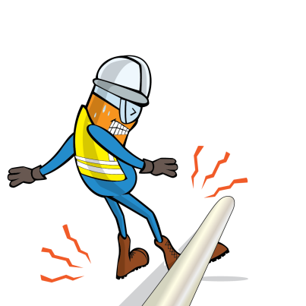
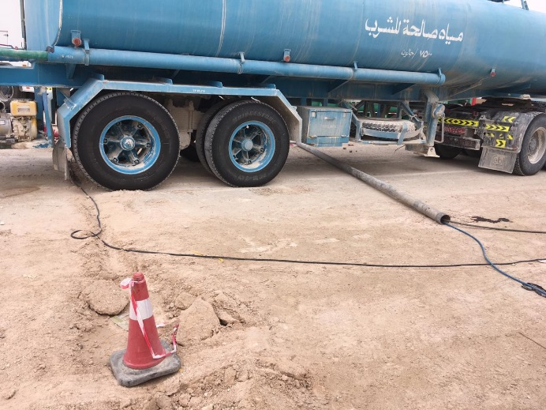
PDO Incident First Alert
Incident type | LTI (#25)
Date/ time | 17.10.201 8 at 09:00hrs. | Directorate
Location | Yibal | Dept
What happened
As a tanker was crossing a partially buried pipe, the wheels passed over and rotated the pipe out of its shallow trench. As the pipe came free, it struck the helper's left leg resulting in a compound fracture.
Mr. Musleh asks the questions of can it happen to you?
Are all your hazards are identified?
Are you standing in in a safe place?
Are you in the ‘line of fire’?
Partially buried pipe dragged from location
Please disseminate this LTI notification to your teams and use it in your tool box talks and HSE meetings and notice boards.

