Slide 1
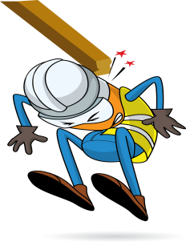
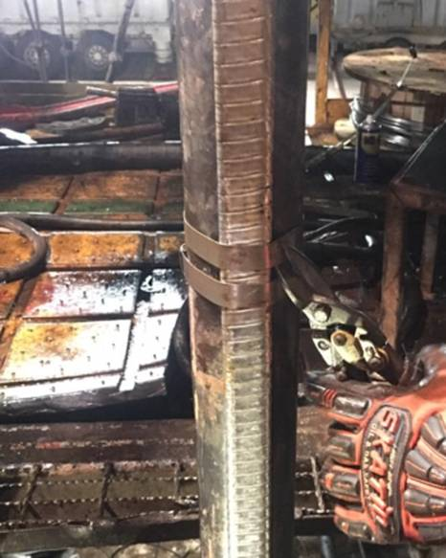
PDO Incident First Alert
Incident type | LTI (#26)
Date/ time | 25.10.201 8 at 23:30hrs. | Directorate
Location | Bahja | Dept
What happened
While the Derrickman was standing in the rig floor to cut the banding of the connected cable to the tubing, the cable suddenly slipped from the tube inside the hole striking him in his left arm causing double fractures.
Mr. Musleh asks the questions of can it happen to you?
Do all hazards are identified in the task you performing?
Are you standing in a safe place?
Are you in the ‘line of fire’?
Please disseminate this LTI notification to your teams and use it in your tool box talks and HSE meetings and notice boards.

