Slide 1
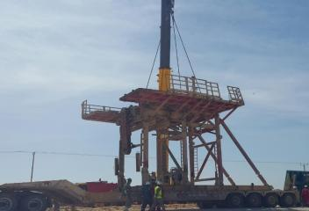
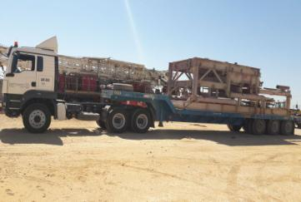
PDO Second Alert
Date: 19.4.2018 Incident title: HiPo
What happened?
At 14:22 hrs. during rig move operations, one of the trailers carrying rig floor substructure rolled over (90⁰) on the graded road between the old and new rig sites. Total distance between both rig sites is 4.5 km, during travelling the driver was maneuvering the vehicle to avoid pot holes on the road. After 1.7km from the old location the driver drove on the road left shoulder which was uneven and caused the truck to tip over due to high center of gravity.
Your learning from this incident…
Always ensure ROP escort is in place for Rig Moves.
Always ensure load is stable and does not have high Center of Gravity.
Always ensure Load is properly positioned and secured on the trailer before move.
Photo explaining what was done wrong
Photo explaining how it should be done right
Ensure that all Rig moves are carried out by competent personnel

Slide 2
Management self audit
Date: 19.04.2018 Incident title: HiPo
As a learning from this incident and to ensure continual improvement , all contract
managers must review their HSE HEMP against the questions asked below
Confirm the following:
Do you ensure Competent personnel are assigned to supervise Rig move activities?
Do you ensure that HEMP covers all rig move activities?
Do you ensure that no shortcuts are taken during rig moves?
Do you ensure that ROP escorting done as per procedure?
Do you ensure that Rig move procedure is understood and implemented?
Notes:
Make a list of closed questions (only ‘yes’ or ‘no’ as an answer) to ask other contractors if they have the same issues based on the management or HSE-MS failings or shortfalls identified in the investigation. Pretend you have to audit other companies to see if they could have the same issues.

