Slide 1
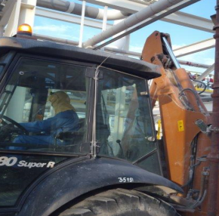
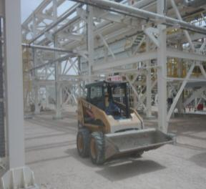
PDO Second Alert
Date: 08.04.2018 Incident: HiPo
What happened?
A Back Hoe Loader carrying back filling material was passing underneath an over head 2-inch dia Instrument air line inside a live gas plant. While passing the line the rear arm of the loader hit the line as the vehicle recoiled when the operator applied brake. Due to the impact the line detached from its threaded flange which caused trip of two running compressors in the station.
Your learning from this incident..
Always check and inspect worksite for obstructions/hazards before vehicle and equipment movement.
Vehicle route map and line walk are mandatory for PTW in live facilities
For any change in equipment, including make and model, follow dynamic risk assessment / MOC process
Always ensure the equipment used for the task is suitable and fit for purpose.
Place warning signs and goal posts at the work site, if height restrictions are identified.
Always use the right equipment for the task

Slide 2
Management self audit
Date: 08.04.2018 Incident: HiPo
As a learning from this incident and ensure continual improvement all contract
managers must review their HSE HEMP against the questions asked below
Confirm the following:
Do you regularly check/inspect worksites for obstructions/Hazards (e.g. height restrictions) before vehicle and Equipment Movement?
Do you ensure that the latest version of PTW formats are being used?
Do you ensure selection of right equipment fit for the job considering the nature of the work site?
Do you follow HSE Dynamic risk assessment / MOC process for any change in equipment including make and model for the job?
Do you ensure that plant and equipment movement/operations inside live facilities are always controlled by banksman?
Do you consider the difference in dimension of equipment’s in HEMP controls / TRIC?
Notes:
Make a list of closed questions (only ‘yes’ or ‘no’ as an answer) to ask other contractors if they have the same issues based on the management or HSE-MS failings or shortfalls identified in the investigation. Pretend you have to audit other companies to see if they could have the same issues.

