Slide 1
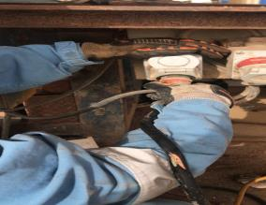
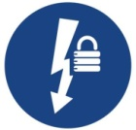
PDO Second Alert
Date: 30.04.2018 Incident title: HiPo
What happened?
During rig up, the night electrician connected the power cables and turned on the light switches from MCC (motor control center). While walk around the electrician noticed that the light on the water tank was not on. Upon inspection he found that the cable to the water tank was not connected. He then attempted to plug the socket and turned it (Twist Switch) to switch on the power.
Unfortunately he did not notice the damaged section (exposed wires) of the cable and got an electric shock on his right arm. Immediately he went to the MCC and turned off the switch. Luckily he didn’t receive any electrical burn.
.
Your learning from this incident..
Always ensure grounding is properly done and tested prior to power up
Always ensure electrical cables are checked for damage
Always ensure isolation before working on energized equipment
Provide onsite supervision to electricians during critical activities.
Connecting cable when the power is on (damaged cable)
Always isolate the power prior to connect the power cables
Isolate the power prior to connect the cables

Slide 2
Management self audit
Date: 30/04/2018 Incident title: HiPo
As a learning from this incident and ensure continual improvement all contract
managers must review their HSE HEMP against the questions asked below
Confirm the following:
Do you ensure that the electrical activities are properly covered in the SOP?
Do you ensure PTW and Isolation process are followed by site teams ?
Do you ensure adequate site supervision provided for the electrician during rig up/down?
Do you ensure electrical system done audit by competent Electrician?
Notes:
Make a list of closed questions (only ‘yes’ or ‘no’ as an answer) to ask other contractors if they have the same issues based on the management or HSE-MS failings or shortfalls identified in the investigation. Pretend you have to audit other companies to see if they could have the same issues.

