Slide 1
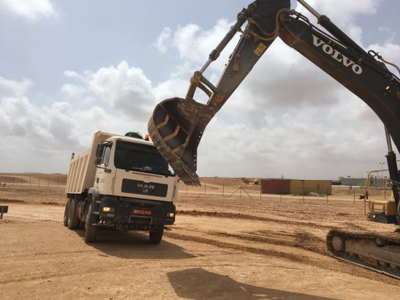
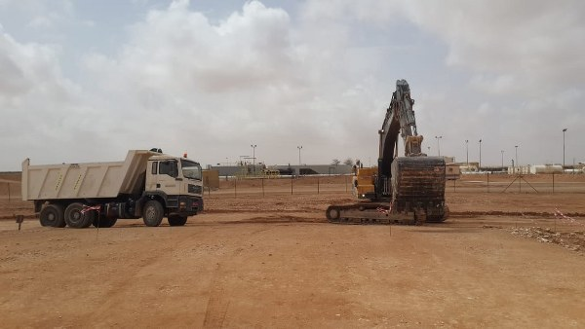
PDO Second Alert
Date: 14.05.2018 Incident Title: HiPo
What happened?
An excavator had returned to site after re-fueling, when a tipper approached the right side of the excavator at the same time as the excavator operator was rotating his machine. The boom of the excavator impacted with the driver's side windscreen partially crushing the cab “A” pillar, the operator lowered his boom switching off his machine and assisted the tipper driver, who was uninjured coming out through the passenger door.
Your learning from this incident..
Keep Safe Distance at all times
If identified as a risk, STOP, fix it!
Communicate to your people don’t assume they know.
Training and Assessment for compliance go hand on hand
Do the job right the first time SAFELY.
Bucket to high & turning towards cab
Tipper to close to excavator
Vehicles to Keep Safe Distance at all times
Tipper to keep safe distance & bucket to slew anti-clock wise and as low as possible

Slide 2
Management self audit
Date: 14/05/2018 Incident Title: HiPo
As a learning from this incident and ensure continual improvement all contract
managers must review their HSE HEMP against the questions asked below
Confirm the following:
Do you ensure that there is a written Hazard and Effects Management Process in place for all tasks.
Do you ensure that all personnel using HEMP competent in identifying and assessing threats and hazards.
Do you ensure that your HEMP is implemented How Effective are your HEMP - Implementation
Does your workforce have a clear understanding how hazards and effects fits into their work environment.
Do you have a system in place to recover any failures in the control of hazards.
Notes:
Make a list of closed questions (only ‘yes’ or ‘no’ as an answer) to ask other contractors if they have the same issues based on the management or HSE-MS failings or shortfalls identified in the investigation. Pretend you have to audit other companies to see if they could have the same issues.

