Slide 1
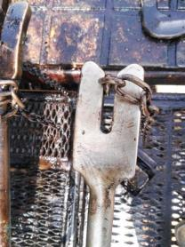
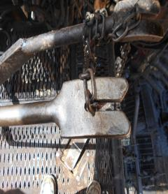
PDO Second Alert
Date: 01.06.2018 Incident title: HiPo
What happened?
During drilling cement operation, the brake lever got released from the chain causing the block to free fall hitting the power swivel and rig floor resulting in asset damage.
Your learning from this incident..
Always ensure the chain brake is properly secured.
Always ensure the well is properly secured before leaving the Driller console.
Always ensure you are trained and authorised for the task.
Always secure the break and well before leaving the rig floor

Slide 2
Management self audit
Date: 01-06-2018 Incident title: HiPo
As a learning from this incident and ensure continual improvement all contract
managers must review their HSE HEMP against the questions asked below
Confirm the following:
Do you ensure you have SOP in place for all tasks?
Do you ensure your teams are aware of all the hazards and risk mitigation during your Tool box talks?
Do you ensure that the employee competence assessment is in place?
Do you ensure that preventive maintenance, as precaution, for handling tools in place as per procedure?
Notes:
Make a list of closed questions (only ‘yes’ or ‘no’ as an answer) to ask other contractors if they have the same issues based on the management or HSE-MS failings or shortfalls identified in the investigation. Pretend you have to audit other companies to see if they could have the same issues.

