Slide 1
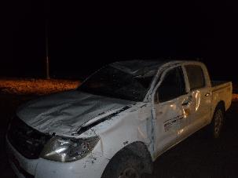
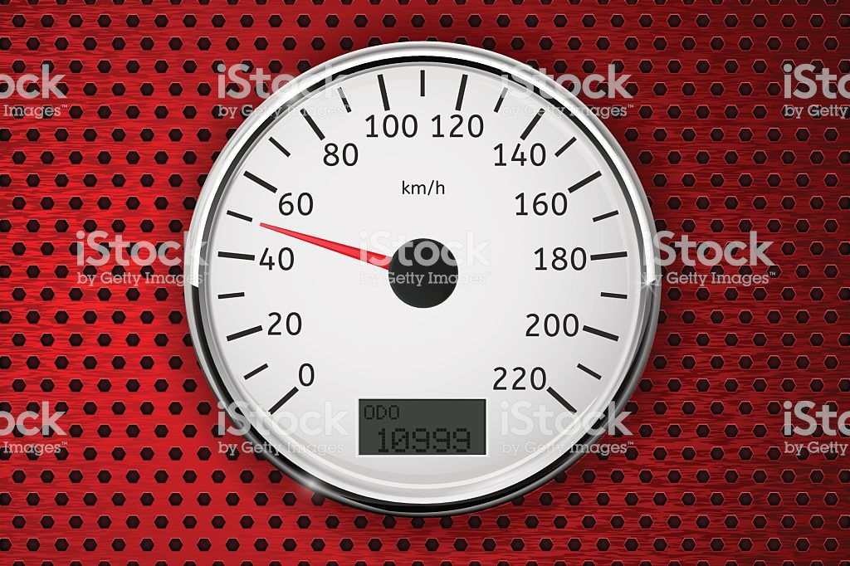
PDO Second Alert
Date: 11.06.2018 Incident title: HiPo
What happened?
Forman Roustabout (Driver) and Roustabout (Passenger) were traveling back from camp to Rig site using Toyota Pickup. Approximately 2.5 km from Rig site, driver approached a S- curve and lost vehicle control which resulted the vehicle to skid out side the road and hit a sand ramp which was in road shoulder and resulted the vehicle to rollover half a turn and rested on its roof.
Driver escaped the vehicle without injury and the Passenger escaped with bruise on his left hand.
Your learning from this incident..
Always ensure to comply with Night Driving Limit of 50 Km/h.
Always ensure vehicles IVMS devices are working.
Always ensure to monitor the vehicle movements between Rig and Camp at Night
Always ensure to comply with emergency response procedure
Always ensure to use approved roads
Always ensure to drive defensively
Reduce Vehicle Speed According to Road Condition

Slide 2
Management self audit
Date: 11.06.2018 Incident title: HiPo
As a learning from this incident and to ensure continual improvement all contract managers must review their HSE HEMP against the questions asked below
Confirm the following:
Do you ensure that all vehicles IVMS is configured as per standard?
Do you ensure the IVMS functionality of replacement vehicles?
Do you ensure all vehicle movements are tracked between work site and accommodation site?
Do you ensure all drivers are aware of IVMS Panic button use?
Do you ensure that all drivers are aware of correct response following a MVI?
Do you ensure that your drivers are aware about night speed limit (50 km/h)?
Do you ensure regular audits of SP2000 and IVMS compliance for you and your contractors?
Notes:
Make a list of closed questions (only ‘yes’ or ‘no’ as an answer) to ask other contractors if they have the same issues based on the management or HSE-MS failings or shortfalls identified in the investigation. Pretend you have to audit other companies to see if they could have the same issues.

