Slide 1
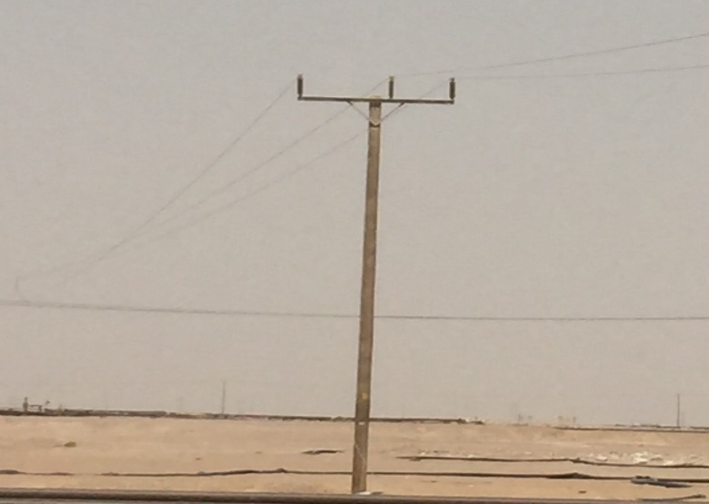
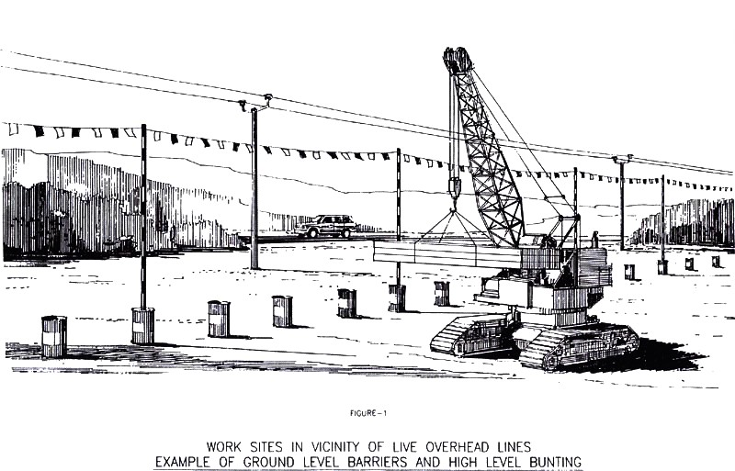
PDO Second Alert
Date:11.06.2018 Incident title: HiPo
What happened?
While the crane operator taking back the slings after offloading the pipe at pipe rack, the slings of the crane contacted with OHL resulted in spark and OHL cut.
Your learning from this incident.
PH should always seek for assistance of PA/Supervisor when you are in doubt.
Always ensure OHL Clearance certificate available / required while working under OHL using lifting equipment.
Ensure Goal post is made while lifting activity carried out near to OHL
PA should ensure Dynamic TRIC been used effectively by PH with proper control measures in place.
Adequate supervision
Always intervene on unsafe acts or conditions.
To be replaced
Ensure OHL Clearance required for your lifting activity

Slide 2
Management self audit
Date: 11.06.2018 Incident title: HiPo
As a learning from this incident and to ensure continual improvement all contract managers must review their HSE HEMP against the questions asked below
Confirm the following:
Do you ensure PA/PH is competent to perform the task?
Do you ensure new PH’s is monitored by Supervisors/ Engineers?
Do you ensure lifting plan available for the activity?
Do you ensure competent staff is assigned for critical lifting activity?
Do you ensure your TBT covers all associated hazards for the activity?
Do you always ensure that you are using the available resources effectively?
Notes:
Make a list of closed questions (only ‘yes’ or ‘no’ as an answer) to ask other contractors if they have the same issues based on the management or HSE-MS failings or shortfalls identified in the investigation. Pretend you have to audit other companies to see if they could have the same issues.

