Slide 1
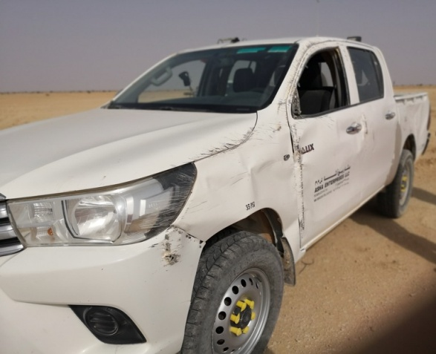
PDO Second Alert
Date: 10.06.2018 Incident title: HiPo
What happened?
At around 12:43 PM on 10th June 2018, one line crew in a Hilux were returning back to camp after finishing the job. On approaching the T junction @ Nimr - Sim Sim on the graded road, control of the vehicle was lost resulting in the vehicle rolling over 90º coming to rest on the driver side. Medic with ambulance was deployed to incident site. On arrival and examination the driver was found with an abrasion on the right hand palm (First aid given) and four passengers with no injuries.
Your learning from this incident..
Always stop at T junction
Always slow down before taking sharp turns
Always pay attention to the road when driving
Always ensure you know your route, if in doubt stop and ask
Always follow defensive driving techniques
Notes:
Ensure all dates and titles are input
A short description should be provided without mentioning names of contractors or individuals. You should include, what happened, to who (by job title) and what injuries this resulted in. Nothing more!
Four to five bullet points highlighting the main findings from the investigation. Remember the target audience is the front line staff so this should be written in simple terms in a way that everyone can understand.
The strap line should be the main point you want to get across
The images should be self explanatory, what went wrong (if you create a reconstruction please ensure you do not put people at risk) and below how it should be done.

Slide 2
Management self audit
Date: 10.06.2018 Incident title: HiPo
As a learning from this incident and to ensure continual improvement all contract managers must review their HSE HEMP against the questions asked below
Confirm the following:
Do you ensure all drivers are trained and experienced?
Do you ensure all drivers are supervised?
Do you ensure driver fatigue is managed?
Do you ensure all drivers are assessed for competency on regular basis?
* If the answer is NO to any of the above questions please ensure you take action to correct this finding.
Notes:
Ensure all dates and titles are input
Make a list of closed questions (only ‘yes’ or ‘no’ as an answer) to ask others if they have the same issues based on the management or HSE-MS failings or shortfalls identified in the investigation.
Imagine you have to audit other companies to see if they could have the same issues.
These questions should start with: Do you ensure…………………?

