Slide 1
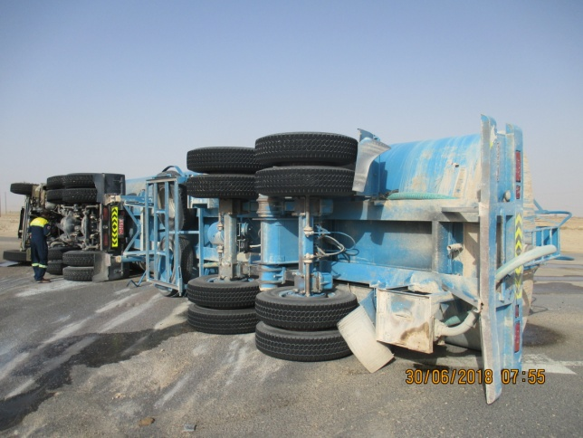
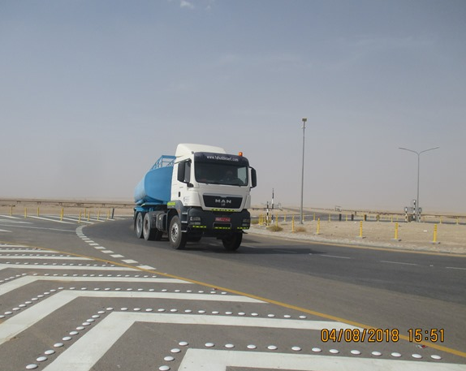
PDO Second Alert
Date: 30.06.2018 Incident title: HiPo
What happened?
On 30^{h} June 2018 at approximately 06:15 hrs, a water tanker on route to Fahud RO Plant (unloaded) from Awaifiah was negotiating the Natih roundabout when it tipped over on to it’s passenger side and skidded approximately 5 meters before coming to a stop. Shortly after the incident the driver was picked up by a passing vehicle which took him to the Fahud Sahara PAC clinic.
There were no other persons or vehicles injured / damaged during this MVI.
Your learning from this incident..
Always ensure you follow your defensive driver training
Always ensure you drive at a speed according to the road conditions
Always ensure you slow down for roundabouts, sharp bends, corners and junctions
Always consider if the signed speed limit may be too high for your vehicle and load type
Always ensure you report road hazards to your supervisor
Always slow down when negotiating roundabouts

Slide 2
Management self audit
Date: 30.06.2018 Incident title: HiPo
As a learning from this incident and to ensure continual improvement all contract managers must review their HSE HEMP against the questions asked below
Confirm the following:
Do you encourage the reporting of road hazards?
Do you ensure road hazard reports are cascaded to the relevant department?
Do you ensure drivers have been briefed and understood relevant safety communications?
Do you ensure your drivers are regularly briefed on following Road Safety Rules?
Do you ensure your drivers undergo regular driving competency assessments?
Do you review driver behaviour regularly?
* If the answer is NO to any of the above questions please ensure you take action to correct this finding.
Notes:
Ensure all dates and titles are input
Make a list of closed questions (only ‘yes’ or ‘no’ as an answer) to ask others if they have the same issues based on the management or HSE-MS failings or shortfalls identified in the investigation.
Imagine you have to audit other companies to see if they could have the same issues.
These questions should start with: Do you ensure…………………?

