Slide 1
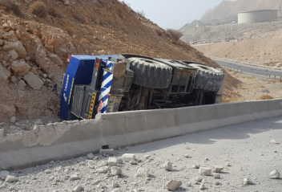
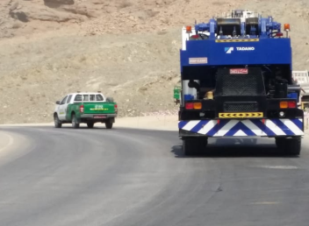
PDO Second Alert
Date:29.06.18 Incident title: HiPo
What happened?
A subcontractor crane was travelling from MAF Upper Tank Farm (UTF) to Lower Tank Farm (LTF). The operator lost control of the crane while he was negotiating a section of black top road with steep docents and bends causing the crane to hit the road barrier wall & light pole. Finally the crane came to halt with tip over to a trench next to the road barrier.
Your learning from this incident..
Be aware of the operational limits and follow Original Equipment Manufacturer guidelines when driving / operating heavy equipment
Always ensure that the speed of the heavy vehicles is safe for the road conditions and design
Always discuss the hazards related to the road conditions and design in Tool Box Talk
Slow down and engage 4x4 gear & exhaust brakes while driving heavy Equipments up or down hill
Notes:
Ensure all dates and titles are input
A short description should be provided without mentioning names of contractors or individuals. You should include, what happened, to who (by job title) and what injuries this resulted in. Nothing more!
Four to five bullet points highlighting the main findings from the investigation. Remember the target audience is the front line staff so this should be written in simple terms in a way that everyone can understand.
The strap line should be the main point you want to get across
The images should be self explanatory, what went wrong (if you create a reconstruction please ensure you do not put people at risk) and below how it should be done.

Slide 2
Management self audit
Date:29.06.18 Incident title: HiPo
As a learning from this incident and to ensure continual improvement all contract managers must review their HSE HEMP against the questions asked below
Confirm the following:
Do you ensure the hazards related to the road conditions and design are discussed in TBT for mobile equipment movement/operations?
Do you ensure that you convey the specific hazards and work conditions to suppliers while hiring heavy equipment?
Do you confirm that the operators are competent for the conditions and aware of OEM guidelines on equipment movement/operations?
Do you ensure your operators of heavy equipment’s are aware of the operational limits of their equipment?
Do you ensure compliance with OEM maintenance/inspection requirements prior to hiring equipment from sub contractors?
* If the answer is NO to any of the above questions please ensure you take action to correct this finding.
Notes:
Ensure all dates and titles are input
Make a list of closed questions (only ‘yes’ or ‘no’ as an answer) to ask others if they have the same issues based on the management or HSE-MS failings or shortfalls identified in the investigation.
Imagine you have to audit other companies to see if they could have the same issues.
These questions should start with: Do you ensure…………………?

