Slide 1
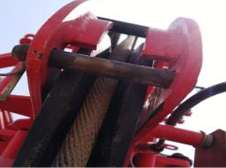
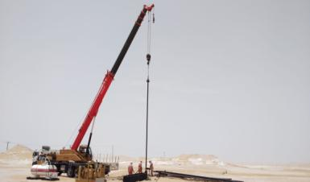
PDO Second Alert
Date: 28.06.2018 Incident title: HiPo
What happened?
While running in hole the 11th joint of 4.5” tubing using the carne auxiliary hook, the Wire rope snapped causing the tubing string to slip into the well and the auxiliary hook to drop approximately half a meter from the wellhead. No one was injured during the incident.
Your learning from this incident..
Always ensure team are aware of load slewing hazards
Always ensure to comply with Lift Plan, TBT and TRIC requirements.
Always ensure to verify that all securing retention are checked
Always ensure key personnel changes are managed through MOC
Load slewing can damage the stopper and push the line out of the pulley
Always ensure straight lifting
Lifting without load slewing
Notes:
Ensure all dates and titles are input
A short description should be provided without mentioning names of contractors or individuals. You should include, what happened, to who (by job title) and what injuries this resulted in. Nothing more!
Four to five bullet points highlighting the main findings from the investigation. Remember the target audience is the front line staff so this should be written in simple terms in a way that everyone can understand.
The strap line should be the main point you want to get across
The images should be self explanatory, what went wrong (if you create a reconstruction please ensure you do not put people at risk) and below how it should be done.

Slide 2
Management self audit
Date: 28.06.2018 Incident title: HiPo
As a learning from this incident and to ensure continual improvement all contract managers must review their HSE HEMP against the questions asked below
Confirm the following:
1 Do you ensure that lift plan is in place for all critical lifting activities?
2 Do you ensure the implementation of lift plans?
3 Do you ensure your supervisors are competent in lifting operations and aware of their responsibilities?
4 Do you ensure the MOC is followed whenever is required?
5 Do you ensure learnings for past incidents are cascaded?
* If the answer is NO to any of the above questions please ensure you take action to correct this finding.
Notes:
Ensure all dates and titles are input
Make a list of closed questions (only ‘yes’ or ‘no’ as an answer) to ask others if they have the same issues based on the management or HSE-MS failings or shortfalls identified in the investigation.
Imagine you have to audit other companies to see if they could have the same issues.
These questions should start with: Do you ensure…………………?

