Slide 1
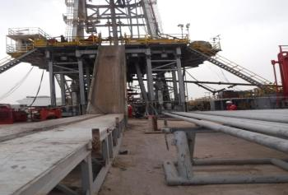
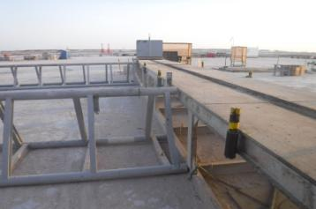
PDO Second Alert
Date: 03.04.2018 Incident title: LTI
What happened?
While laying down 4” drill pipe from rig floor, roustabout went up on the catwalk to remove the lifting cap. After removing the lifting cap roustabout pushed the drill pipe backward on the roller bars, the pipe moved toward edge of catwalk, knocking roustabout to ground (approximately 1.1 meter height) and DP landed on his left leg above ankle resulting in a fracture to his left leg.
Your learning from this incident..
Ensure roustabouts have clear task instructions
Ensure pull push stick are used where appropriate
Always make sure that intervention is implemented on your sites
Ensure all supervisors and crews are using learning from incidents
Ensure all task specific hazards and controls are discussed in TBT meeting.
Ensure access to catwalk is restricted during operation.
Always ensure all stoppers are in place if pipe racks are removed

Slide 2
Management self audit
Date: 03.04.2018 Incident title: LTI
As a learning from this incident and to ensure continual improvement all contract managers must review their HSE HEMP against the questions asked below
Confirm the following:
Do you ensure that adequate supervision for the ongoing jobs/activities all the time?
Do your supervisors plan the job and identify the associated risks before starting the job?
Do your supervisors prioritize the job before assigning the tasks to crew?
Notes:
Make a list of closed questions (only ‘yes’ or ‘no’ as an answer) to ask other contractors if they have the same issues based on the management or HSE-MS failings or shortfalls identified in the investigation. Pretend you have to audit other companies to see if they could have the same issues.

