Slide 1
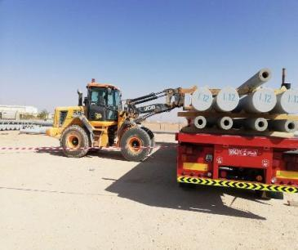
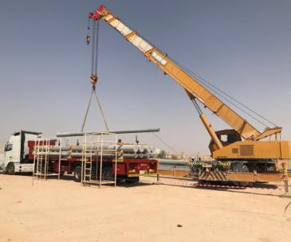
PDO Second Alert
Date: 18.04.2018 Incident title: Fatality
What happened?
While unloading OHL concrete poles from the trailer using tool carrier, the pole swung and hit the right chest area of the worker who was standing between the poles resulting in crush injury.
Your learning from this incident..
Use the right equipment for the job
Always stand clear of line of fire
Ensure the lifting equipment is suitable for lift operation and shall meet PDO requirements
Ensure all lifting equipment are certified and the lifting crew are competent
Ensure the lift plan is in place and make sure TBT is conducted
Always use correct lifting equipment
Notes:
Ensure the lifting equipment is suitable for lift operation and shall meet PDO procedure PR-1708 & SP-2273 requirements
•Ensure all lifting equipment are certified and the lifting crew are competent
•Ensure the lift plan is in place and make sure TBT is conducted

Slide 2
Management self audit
Date: 18.04.2018 Incident title: Fatality
As a learning from this incident and to ensure continual improvement all contract managers must review their HSE HEMP against the questions asked below
Confirm the following:
Do you ensure you identify all hazards before starting a task?
Do you ensure that competent personnel are assigned for the job?
Have you ensured that right equipment is provided for executing the job?
Do you ensure you are in a safe position while performing lifting operations?
Have you created awareness on safe behavior to avoid crush points?
Do your lifting procedures comply with that of PDO?
Do you ensure that learning from incidents are cascaded and implemented effectively?
Do you include yard activities in daily work plan?
Do your ensure that lifting activities are supervised by a competent person?
Notes:
Make a list of closed questions (only ‘yes’ or ‘no’ as an answer) to ask other contractors if they have the same issues based on the management or HSE-MS failings or shortfalls identified in the investigation. Pretend you have to audit other companies to see if they could have the same issues.

