Slide 1
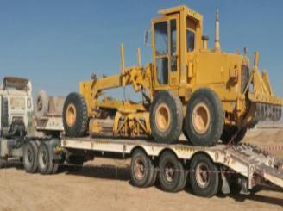
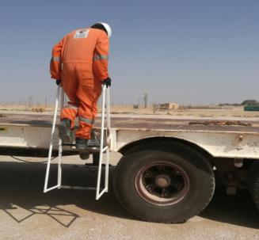
PDO Second Alert
Date: 29.04.2018 Incident: LTI #11
What happened?
After checking his load security, a driver was getting down from a Low bed Trailer when he lost his balance and fell resulting in a fracture to his left wrist.
Your learning from this incident..
Always ensure to use safe access.
Ensure three point contact while ascending and descending
Report all congested work floor hazards at site.
Always carryout load restraint from the ground
Fell from here
Use safe access to avoid falls
Detachable access ladder provided

Slide 2
Management self audit
Date: 29.04.2018 Incident: LTI #11
As a learning from this incident and to ensure continual improvement all contract managers must review their HSE HEMP against the questions asked below
Confirm the following:
Do you ensure that employees working in trailer are using safe access and egress?
Do you always ensure that your employees keep 3 points of contact while ascending/ descending?
Do you always ensure safe accessibility for restraining equipment in a low bed trailer?
Do you encourage your employees to report unsafe conditions to supervisor?
Do you ensure timely reporting to PDO emergency number during medical emergency?
Notes:
Make a list of closed questions (only ‘yes’ or ‘no’ as an answer) to ask other contractors if they have the same issues based on the management or HSE-MS failings or shortfalls identified in the investigation. Pretend you have to audit other companies to see if they could have the same issues.

