Slide 1
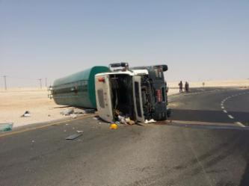
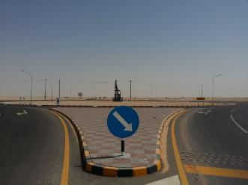
PDO Second Alert
Date: 14.05.218 LTI # 12
What happened?
While taking the roundabout ; the driver lost control of the tanker tipping over onto its right side. The helper sustained multiple soft tissues injuries and driver minor abrasions.
Your learning from this incident..
Always drive as per the road conditions.
Always follow defensive driving practices .
Always deploy experienced and competent driver
REDUCE SPEED BEFORE ROUND ABOUT

Slide 2
Management self audit
Date: 14.05.218 LTI # 12 .
As a learning from this incident and to ensure continual improvement all contract managers must review their HSE HEMP against the questions asked below
Confirm the following:
Do you ensure all your employees are experienced and competent to carryout the task?.
Do you ensure the compliance of the requirements of per SP 2000 for licensing of drivers?
Do you ensure that the activities and movements of sub-contractors and hired services are closely monitored and audited?
Do you ensure that all employees are included in Tool Box Talks for their activities on a daily basis
Notes:
Make a list of closed questions (only ‘yes’ or ‘no’ as an answer) to ask other contractors if they have the same issues based on the management or HSE-MS failings or shortfalls identified in the investigation. Pretend you have to audit other companies to see if they could have the same issues.

