Slide 1
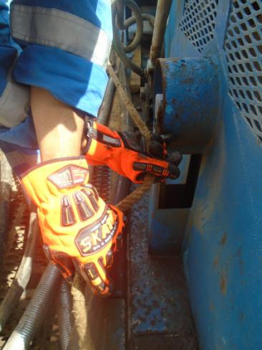
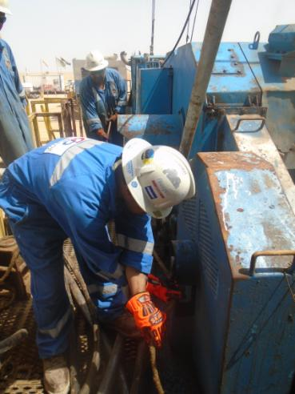
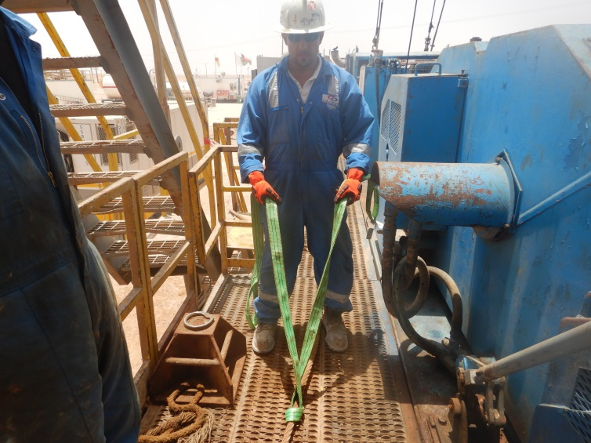
PDO Second Alert
Date: 16.05.2018 Incident title: LTI
What happened?
At approximately 19:00hrs on 16th May, Rig crew members were in process of Rigging up. The Driller and Derrick Man were on the rig carrier, pulling the guy lines for clearing away from the mast prior to raising the mast. Derrick man was holding a guy line near the draw works which was stuck at the Hydo-matic coupling side and at the same time it was pulled rapidly by the Driller. The sudden force resulted in hitting the right hand little finger of the Derrick man on the guard of the Hydo-matic coupling of draw-works. Derrick man was taken to the government clinic where X ray revealed fracture.
Your learning from this incident..
Ensure supervisors are providing effective supervision whilst Rig up and not to involved in the task.
Ensure adequate personnel are available to carry out the task.
Supervisors to ensure task hazards are identified and explained to the crew members.
Always maintain good communication.
Always ensure hands are away from pinch points.
Driller standing behind the Derrick man and pulling the guy lines
Use Hands Free Lifting Aids
Use hands free lifting aids for pulling guy lines

Slide 2
Management self audit
Date: 16.05.2018 Incident title: LTI
As a learning from this incident and to ensure continual improvement all contract managers must review their HSE HEMP against the questions asked below
Confirm the following:
Do you ensure the learning from incidents are implemented at each location?
Do you ensure Supervisors are not involved in the task and provide supervision?
Do you ensure pinch points are identified and register is updated?
Do you ensure MOC carried out when you have crew shortage?
Do you have HEMP for handling guy lines?
Notes:
Make a list of closed questions (only ‘yes’ or ‘no’ as an answer) to ask other contractors if they have the same issues based on the management or HSE-MS failings or shortfalls identified in the investigation. Pretend you have to audit other companies to see if they could have the same issues.

