Slide 1
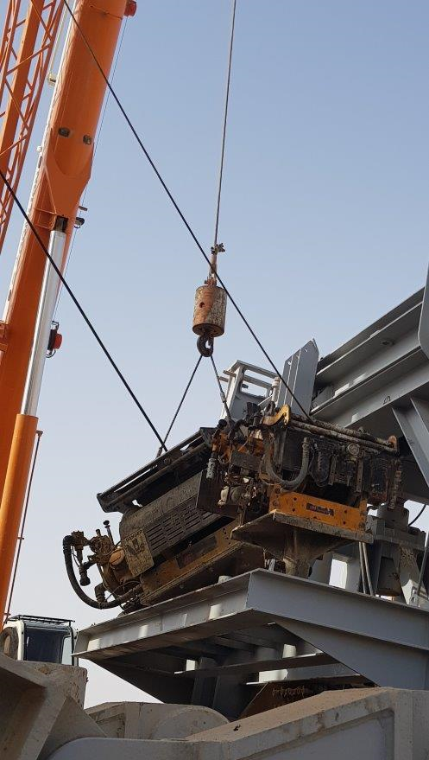
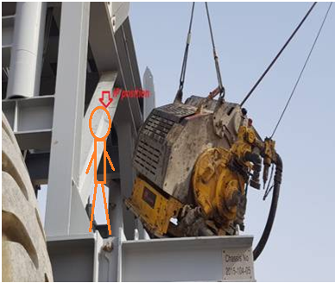
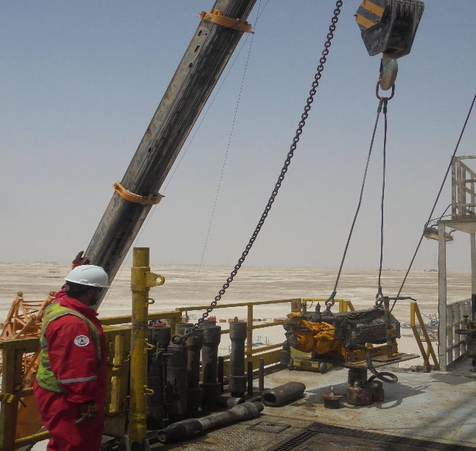
PDO Second Alert
Date: 15.06.2018 Incident title: LTI
What happened?
While mast lowering preparation, a roustabout was assigned to guide the winch and install locking pin. Assistant driller was acting as banksman in order to set the winch on its base, while doing so the utility winch imbalanced and swung, which resulted in Roustabout left arm being caught between the winch and dolly beam.
Your learning from this incident..
Highlight any design issues or difficulties to your supervisor and management
Always use two leg wire rope sling with D-link to lift the utility winches.
Ensure valid PTW,TRIC and lift plan is obtained for critical tasks
Stopped the job if it is not safe to do so.
Always stay away from line of fire

Slide 2
Date: 15.06.2018 Incident title: LTI
As a learning from this incident and to ensure continual improvement all contract
managers must review their HSE HEMP against the questions asked below
Confirm the following:
Do you ensure adequate lifting plans are in place for all lifting activities?
Do you ensure new designs have a full review of HEMP?
Do your ensure supervisors plan the job and identify the associated risks before starting the job?
Do you ensure adequate use of PTW for all required tasks?
Notes:
Make a list of closed questions (only ‘yes’ or ‘no’ as an answer) to ask other contractors if they have the same issues based on the management or HSE-MS failings or shortfalls identified in the investigation. Pretend you have to audit other companies to see if they could have the same issues.

