Slide 1
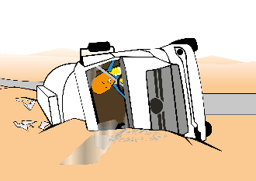
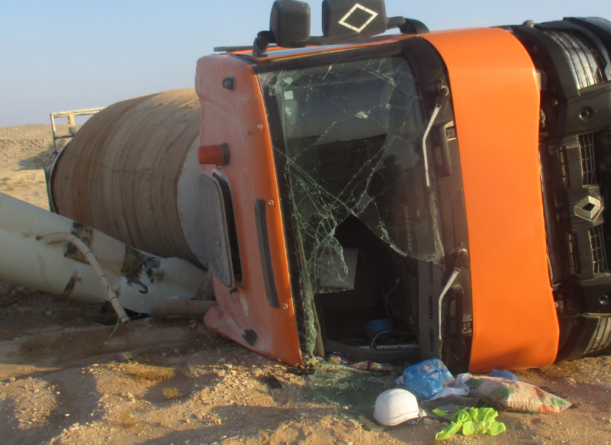
PDO Incident First Alert
Incident type | LTI (#28)
Date/ time | 27.11.2018 at 15:00hrs. | Directorate
Location | Harweel - Sarmad | Dept
What happened
A Transit Mixer driver and helper were traveling toward Harweel. While negotiating a left turn the driver lost control of the vehicle resulting in the Transit Mixer tipping over on to its right side. Resulting a fracture to the helper right wrist.
Mr. Musleh asks the questions of can it happen to you?
Do you driving if you feel fatigue?
Are you committed with the speed limits in the graded road?
Do always use correct designated road ?
Do you always wear your seatbelt?
Please disseminate this LTI notification to your teams and use it in your tool box talks and HSE meetings and notice boards.

