Slide 1
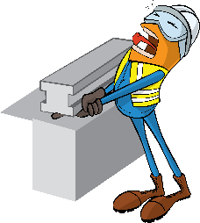
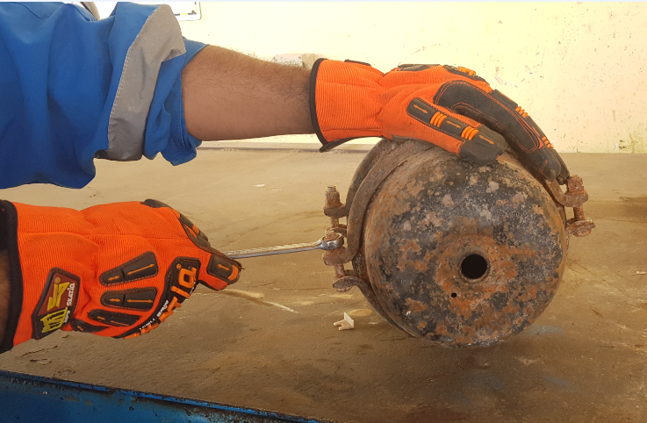


PDO Incident First Alert
Incident type | LTI (#30)
Date/ time | 14.12.2018 at 11:10 hrs. | Directorate
Location | Nimr | Dept
What happened
The mechanic was replacing a new brake booster on trailer as it did not fit, he loosened the clamp without engaging the release (safety pin) which was securing the compressed spring chamber. Consequently, the compressed spring chamber cap was released and struck him in his right eyebrow causing deep laceration.
Mr. Musleh asks the questions of can it happen to you?
Are you aware of all hazards that are identified in the task you performing?
Aer you aware of the risk of stored energy?
Are you in the ‘line of fire’?
Do you wear your full PPE?
Please disseminate this LTI notification to your teams and use it in your tool box talks and HSE meetings and notice boards.

