Slide 1
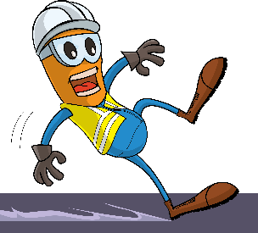
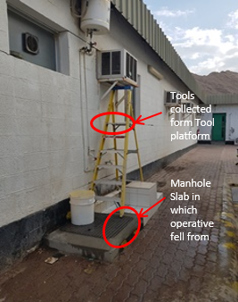


PDO Incident First Alert
Incident type | LTI (#31)
Date/ time | 16.12.2018 at 09:30 hrs. | Directorate
Location | MAF | Dept
What happened
After replacing the water heater, the electrician was removing his toolbox when he stepped backward lost his balance and slipped landing on his left hand. He was diagnosed with fractured wrist.
Mr. Musleh asks the questions of can it happen to you?
Are you aware of all hazards associated with the task you performing?
Do you maintain good housekeeping at your work Area ?
Do you wear the correct type of boot?
Please disseminate this LTI notification to your teams and use it in your tool box talks and HSE meetings and notice boards.

