Slide 1
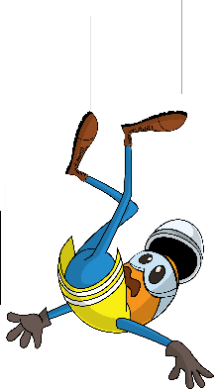
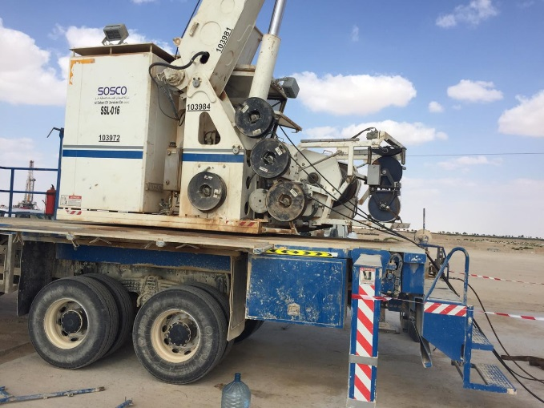


PDO Incident First Alert
Incident type | LTI (#32)
Date/ time | 18.12.2018 at 12:00 hrs. | Directorate
Location | Marmul | Dept
What happened
While the engineer was standing on the unit platform to take the pressure reading, he lost his balance and fell 1.5 meter to the concrete ground landing on his right hand. He was diagnosed with fractured right wrist.
Mr. Musleh asks the questions of can it happen to you?
Do you always pay attention to where you are standing?
Do you ensure you have safe access and egress?
Do you ensure you maintain good housekeeping?
Do you always ensure you are protected from fall from height ?
Please disseminate this LTI notification to your teams and use it in your tool box talks and HSE meetings and notice boards.

