Slide 1
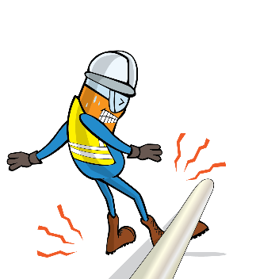
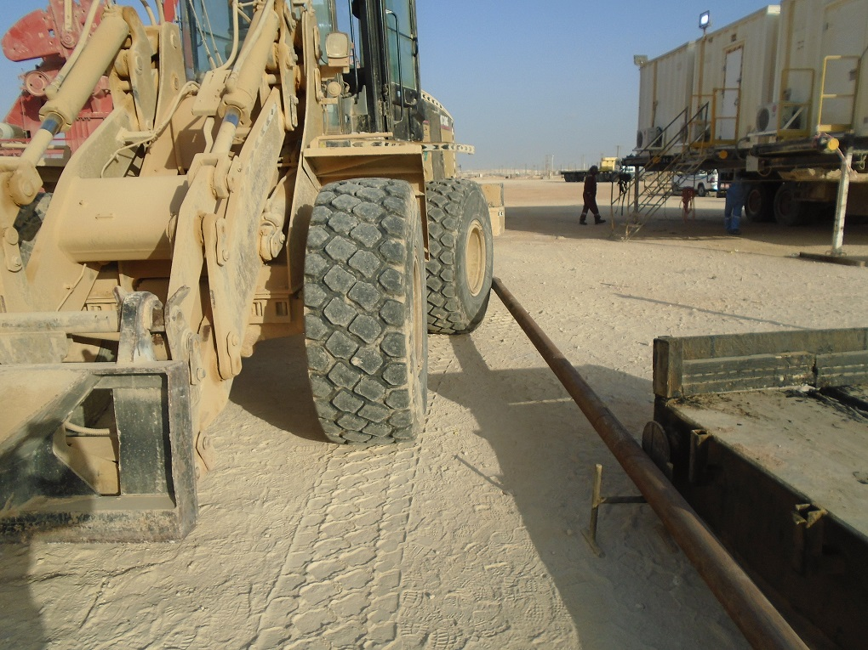


PDO Incident First Alert
Incident type | LTI (01)
Date/ time | 03.02.19@ 13:45hrs | Directorate
Location | Amal | Dept
What happened
While the forklift was performing a reverse maneuver, it tapped on one side of the tubing causing the other side to fall to the ground and strike the derrickman’s right foot fracturing the ankle’s joint.
Mr. Musleh asks the questions of can it happen to you?
Do you ensure you have a banksman on the site?
Do you ensure you have a good communication with colleagues?
Do you ensure you identify all hazards before starting a task?
Do you always consider if you are in the ‘line of fire’?
Please disseminate this LTI notification to your teams and use it in your tool box talks and HSE meetings and notice boards.

