Slide 1
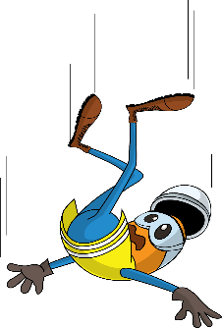
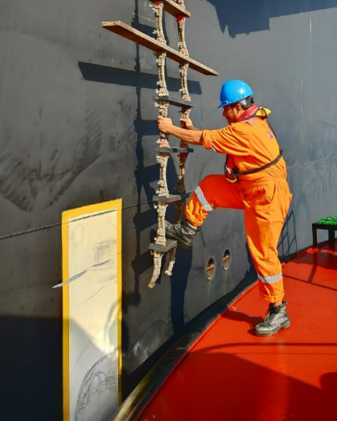
PDO Incident First Alert
Incident type | LTI (02)
Date/ time | 12.02.19@ 21:15hrs | Directorate
Location | MAF | Dept
What happened
While boarding a vessel during moderate sea condition, as the pilot boat approached the pilot ladder when the sea dipped causing, the inspector lost his balance and fell into the water. He was immediately rescued and evacuated to PDO MAF clinic. After preliminary examination and treatment he was referred to KIMS where he was diagnosed with fractured right shoulder.
Mr. Musleh asks the questions of can it happen to you?
Do you ensure all hazards are identified before performing the task?
Do you ensure the weather is suitable for the task?
Do you ensure you have a good communication with colleagues?
Do you always consider if you are in the ‘line of fire’?
Please disseminate this LTI notification to your teams and use it in your tool box talks and HSE meetings and notice boards.

