Slide 1
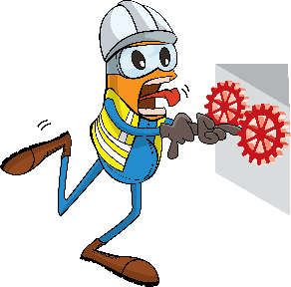
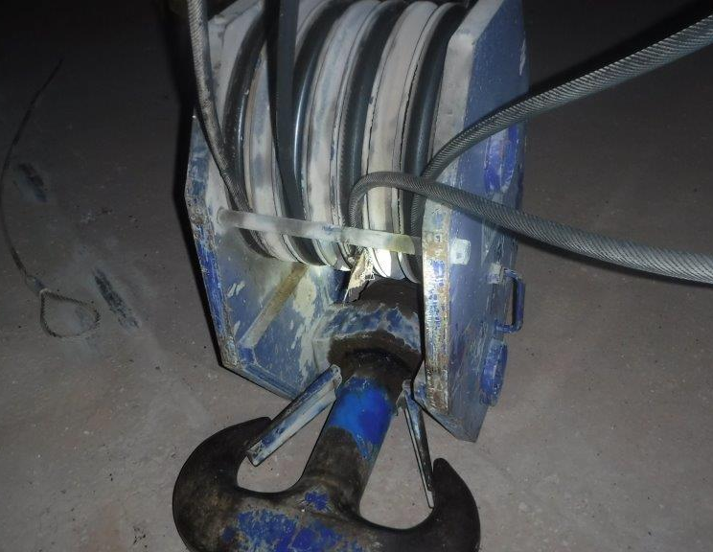
PDO Incident First Alert
Incident type | LTI (03)
Date/ time | 15.02.19@ 21:15hrs | Directorate
Location | Harweel | Dept
What happened
While attempting to pull a snagged line in the crane sheave block a second crane operator’s hand was trapped when the block dropped suddenly injuring his finger.
Mr. Musleh asks the questions of can it happen to you?
Do you ensure all hazards are identified before performing the task?
Do keep your hands and fingers out of crush points?
Do you always consider if you are in the ‘line of fire’?
Reconstruction only hook was not on the ground.
Please disseminate this LTI notification to your teams and use it in your tool box talks and HSE meetings and notice boards.

