Slide 1
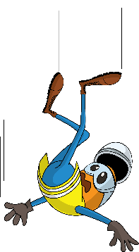
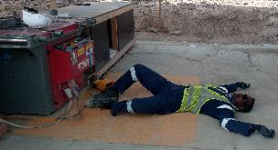
PDO Incident First Alert -
Incident type | LTI (04)
Date/ time | 07.03.19@ 07:15hrs | Directorate
Location | MAF | Dept
What happened
While working on rebar bending activity at the steel workshop, the steel fixer bruised the tip of his left hand ring finger and received first aid onsite. He later felt dizzy then fainted and fell to the ground striking his head causing a fracture to the skull.
Mr. Musleh asks the questions of can it happen to you?
Do you ensure you are fit prior to start any activity ?
Do you have any medical history?
Do you report to your supervisory if you feel unwell ?
Please disseminate this LTI notification to your teams and use it in your tool box talks and HSE meetings and notice boards.

