Slide 1
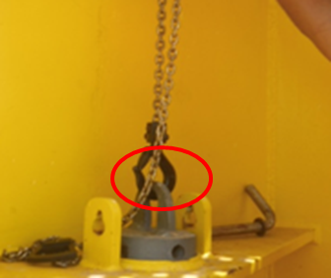
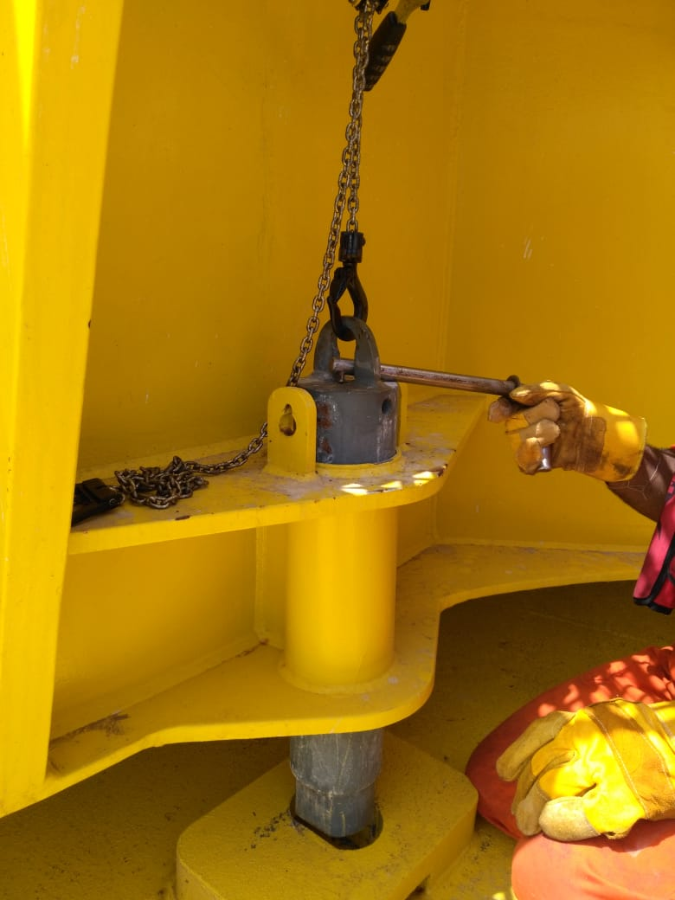
PDO Second Alert
Date: 08 July 2018 Incident title: LTI
What happened?
On the 8th of July at 07:05 the diver was instructed to proceed to conduct the morning inspection for all the offshore assets. Whilst inspecting the offshore loading buoy # 3 the diver attempted to lock the turntable as this would be needed for other work later the same day. He tried to lock the loading buoy with the locking pin, which is lowered by a small lever hoist into a securing pot. The locking pin did not drop home. The diver then, with the right hand on the locking pin pad eye and hook, and with the left hand on the pin body, attempted to rotate the locking pin. As the locking pin dropped home the tip of the diver's right hand, middle finger was caught in the pinch point between the lever hoist hook and the pad eye.
Your learning from this incident..
Always ensure you keep your hands and fingers away from pinch points.
Always ensure you identify all hazards before starting a task.
Always ensure you have considered the use of a tool instead of using your hands.
Always ensure you understand the instruction given before starting any job.
Use a tool and protect your hands
Notes:
Ensure all dates and titles are input
A short description should be provided without mentioning names of contractors or individuals. You should include, what happened, to who (by job title) and what injuries this resulted in. Nothing more!
Four to five bullet points highlighting the main findings from the investigation. Remember the target audience is the front line staff so this should be written in simple terms in a way that everyone can understand.
The strap line should be the main point you want to get across
The images should be self explanatory, what went wrong (if you create a reconstruction please ensure you do not put people at risk) and below how it should be done.

Slide 2
Management self audit
Date: 08 July 2018 Incident title: LTI
As a learning from this incident and to ensure continual improvement all contract managers must review their HSE HEMP against the questions asked below
Confirm the following:
Do you ensure that all hazards are identified and captured in HEMP?
Do you ensure that you have a procedure for all your activities?
Do you ensure that all TBTs are effective?
Do you ensure that all team members are present for the TBT?
* If the answer is NO to any of the above questions please ensure you take action to correct this finding.
Confidential - Not to be shared outside of PDO/PDO contractors
Notes:
Ensure all dates and titles are input
Make a list of closed questions (only ‘yes’ or ‘no’ as an answer) to ask others if they have the same issues based on the management or HSE-MS failings or shortfalls identified in the investigation.
Imagine you have to audit other companies to see if they could have the same issues.
These questions should start with: Do you ensure…………………?

